Slide 1

Wyoming Department of
Workforce Services
Research & Planning
Labor Market Information for Wyoming
Presented at the Other Ways to Win: Career Readiness Seminar, Casper, WY
by Sara Saulcy, Senior Economist and
Patrick Manning, Principal Economist
December 1, 2012

Slide 2
Who is Research & Planning?
OUR ORGANIZATION:
R&P is a separate, exclusively statistical entity.
WHAT WE DO:
R&P collects, analyzes, and publishes timely and accurate labor market information (LMI)
meeting established statistical standards.
OUR CUSTOMERS:
LMI makes the labor market more efficient by
providing the public and the public’s
representatives with the basis for
informed decision making.

Slide 3
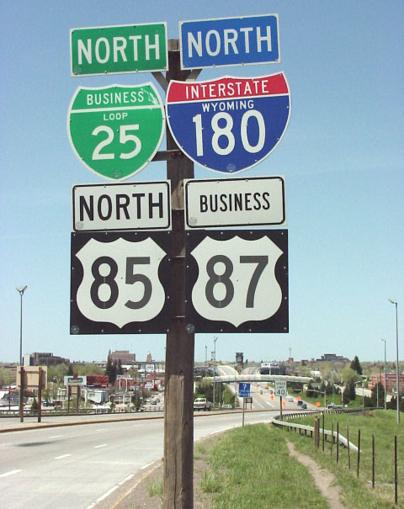
Presentation Road map
Sara Saulcy
What’s the difference between occupations and industries?
Resources from:
  Wyoming Department of Workforce Services (WY-DWS)
  U.S. Department of Labor (USDOL)
  Selected non-government resources
Pat Manning
Projections
  Factors which influence projections
  Industry projections
  Occupational projections
Other factors to consider for careers
Employer-provided benefits

Slide 4

Occupations and Industries
What’s the Difference?
Occupation: A set of activities or tasks that employees are paid to perform. Employees who perform essentially the same tasks are in the same occupation, whether or not they work in the same industry.
Industry: A group of similar establishments that produce similar products or provide similar services.

Slide 5

Occupations and Industries
What’s the Difference?
A single occupation may appear frequently across many industries.
Example: Accountants work in virtually every industry, including:
  Elementary and secondary schools
  General freight trucking
  Amusement parks & arcades
  Oil & gas extraction.

Slide 6
Occupations and Industries
What’s the Difference?
The Wyoming Quarterly Census of Employment & Wages report for first quarter 2012 shows 18,642 jobs in the construction industry.
Doesn’t mean that all of these employees worked on a construction site.
Firms in the construction industry may employ receptionists, human resource managers, computer support specialists, and other workers who are included in the total.

Slide 7
Career and Occupational Resources from WY-DWS
Wyoming Department of Workforce Services, Wyoming at Work site: https://www.wyomingatwork.com/
  “One-stop shopping” for
    Employers looking for workers, money to train workers, and other resources
    Employees looking for career guidance, jobs, work or training resources
  Includes a link to R&P’s labor market information site

Slide 8

Career and Occupational Resources from WY-DWS
Wyoming Department of Workforce Services, Research & Planning Career Information page: http://doe.state.wy.us/lmi/career.htm
  Licensed occupations directory
  Wyoming Career Explorer 2011
  Links to Wyoming community colleges and the University of Wyoming

Slide 9
Career and Occupational Resources from WY-DWS
Occupational Employment Statistics: http://doe.state.wy.us/lmi/oes.htm
  Survey of employers about occupations and associated wages
  Data available for Wyoming and substate regions
  Wage data to be discussed later as part of projections
New hires survey: http://doe.state.wy.us/lmi/newhires.htm
  Survey of employers about workers they’ve recently hired
    Wages, benefits, other compensation
    Importance of various job skills to employers
    Demographic characteristics
    Industries

Slide 10
Career and Occupational Resources from WY-DWS
Benefits survey: http://doe.state.wy.us/lmi/benefits.htm
  Survey of employers about benefits they provide (or not) to their employees
    Data by employer size and industry
Quarterly Census of Employment and Wages: http://doe.state.wy.us/lmi/toc_202.htm
  Describes employment & wages in Wyoming by industry, county, and other characteristics
Growing and declining industries: http://doe.state.wy.us/lmi/industries.htm
  Industries in which the employment level is increasing/decreasing by 5% or more for two quarters over the year period

Slide 11
Career and Occupational Resources from USDOL
Publication: “High Wages After High School – Without a Bachelor’s Degree,” from the U.S. Department of Labor, Bureau of Labor Statistics: www.bls.gov/opub/ooq/2012/summer/art03.pdf
  Includes information about:
    Occupations which have median annual wages of $50,000 or higher as of May 2010 that don’t require a Bachelor’s degree
    Work experience requirements and types of on-the-job training
    Projected growth in the U.S. for these occupations

Slide 12
Career and Occupational Resources from USDOL
U.S. Department of Labor, Employment & Training Administration O*NET Resource Center: http://www.onetcenter.org/
  Good resource for learning about careers in general such as what types of knowledge, skills, and abilities are required
  Information about national employment trends and wages.

Slide 13

Career and Occupational Resources from USDOL
U.S. Department of Labor, Employment & Training Administration CareerOneStop site: http://www.careeronestop.org/
  Provides guidance about career exploration, U.S. wage information, job search, and resume and interviewing skills.
  Also on the site is information specific to “green” careers, e.g., wind turbine installers.

Slide 14
Non-Government Career and Occupational Resources
CareerPath.com: http://www.careerpath.com
  Associated with the Career Builder website
  Provides career planning, tests, and advice
Forbes magazine online, “The Best Jobs That Don't Require A Bachelor's Degree:” http://www.forbes.com/sites/jennagoudreau/2012/06/21/the-best-jobs-that-dont-require-a-bachelors-degree/
  Discusses the pitfalls of earning a Bachelor’s degree
  Refers readers to jobs which are high paying but don’t require a Bachelor’s

Slide 15

Non-Government Career and Occupational Resources
Green Careers Guide: http://www.greencareersguide.com/#
  Has a wide range of resources for individuals interested in pursuing “green” careers

Slide 16
~Projections
~Other Factors to Consider for a Career
~Employer-Provided Benefits

Slide 17
Occupation Replacement Need and Projections
Replacement Need
Due to the aging of the ‘Baby Boom’ generation (those born between 1946 and 1964) the average age of the United States workforce is increasing
The age of Wyoming’s workforce is aging at a higher rate than the U.S. overall
Regardless of whether a particular occupation is expected to grow in terms of total employment, there is a substantial need to replace members of the ‘Baby Boomer’ generation that are retiring

Slide 18
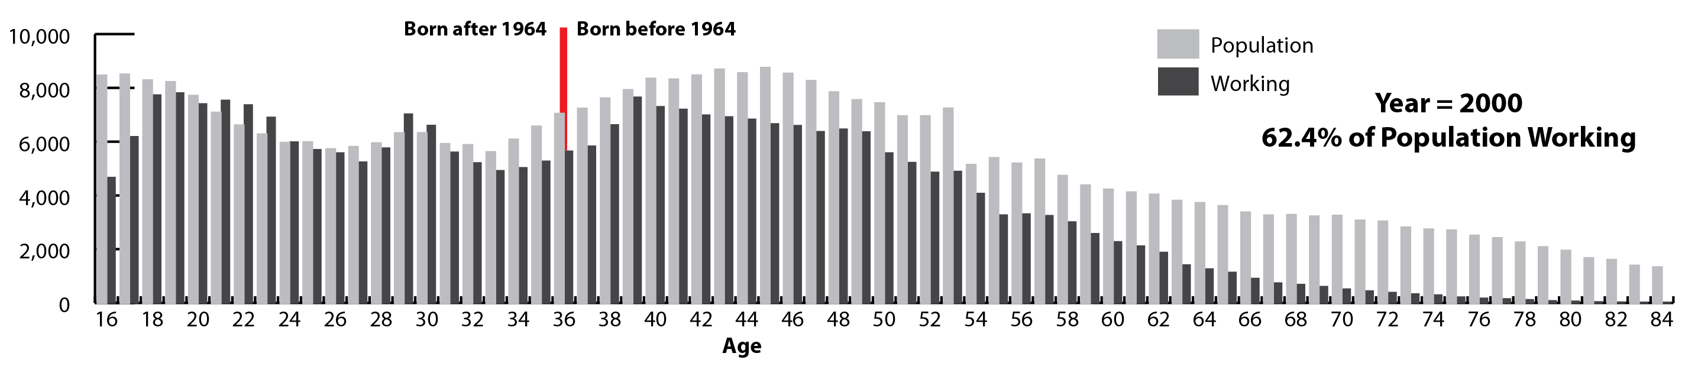
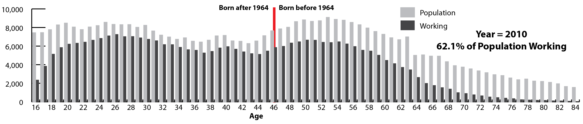
Replacement need (cont.): Aging of WY workforce

Slide 19
Occupation Replacement Need and Projections (cont.)
Replacement Need versus Job Growth
For example, for ‘All Occupations’, growth is expected to be 15% from 2011-2021 (1.5% per year).
This corresponds to new annual openings of 4,087 per year due to growth
However, due to replacement needs, there are expected to be 27,747 openings per year over this time period
  Replacement Need is due to:
    Retirement
    People leaving the workforce for other reasons
    People that leave industries and never come back

Slide 20

Projection Caveats
Many things can affect (or completely invalidate) various economic projections.
Unforeseen Events
  (September 11, 2001)
    Effects on security occupations (demand greatly increased)
    Effects on airline occupations (demand decreased, at least in the short run)
Unusual disturbances in the business cycle (e.g. The Great Recession)

Slide 21
Projection Caveats (cont.)
Changes in Technology in Various Industries or Occupations
  Various industries have become more capital-intensive and less labor intensive over time (e.g. row crop farming )
  Web Developers did not exist 30 years ago
  There are very few telegraph operators these days
Changes in legislation
  The Patient Protection and Affordable Care Act of 2010
  American Recovery and Reinvestment Act of 2009
Notes:
475012 - Rotary Drill Operators Oil and Gas

Slide 22
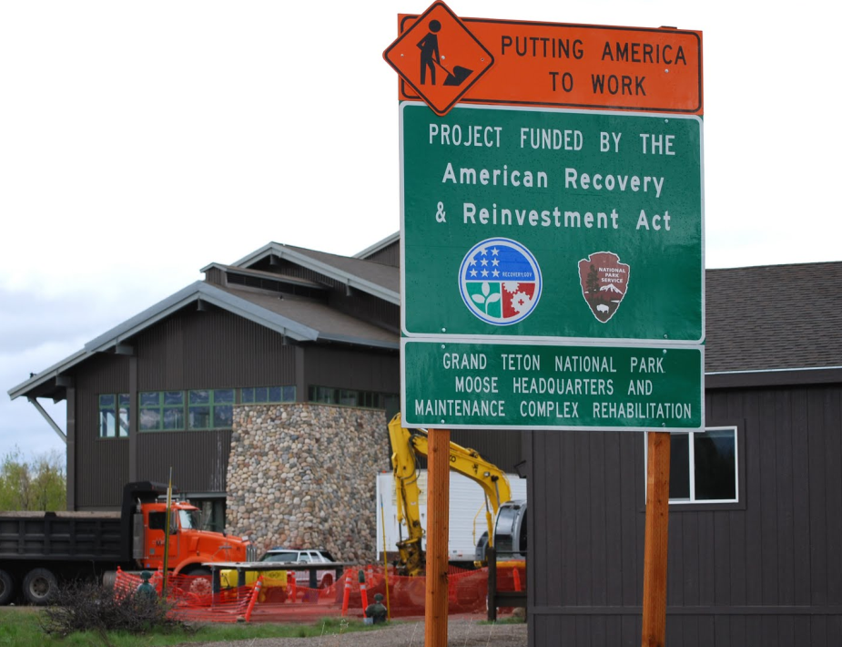
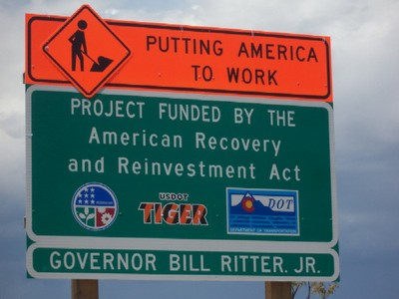
American Recovery and Reinvestment Act
Legislation that injected funds into the U.S. economy in an attempt to stimulate an economic recovery
  Education (e.g. state fiscal relief to prevent cuts in education aid and provide block grants)
  Health Care (e.g. continued COBRA coverage for the involuntarily unemployed)
  Public Works Projects (pictured below)

Slide 23
Projections
Conducted for occupations and industries
Short-term projections cover a 2-year period for industries only
Long-term projections are for both industries and occupations and cover a 10-year period
Long-term Sub-state projections are available by industry
Projections are updated ever other year
http://doe.state.wy.us/lmi/projections.htm

Slide 24



Industry Projections (2011-2021)
Top 5 Industries in Terms of Overall Job Growth
1. Health Care and Social Assistance
  (926 openings/year, 3,591 replacement need/year)
2. Mining Industry
  (846 openings/year, 2,455 replacement need/year)
3. Educational Services
  (811 openings/year, 2,556 replacement need/year)

Slide 25


Industry Projections (2011-2021)
Top 5 Industries in Terms of Overall Job Growth
4. Public Administration
  (288 openings/year, 2,220 replacement need/year)
5. Transportation and Warehousing
  (274 openings/year, 1,153 replacement need/year)

Slide 26
Occupational Projections 2011-2021
Top 5 Occupations in terms of overall job growth
1. Operating Engineers and other construction equipment operators
  151 openings/year, 447 replacement need/year
  Avg. wage $47,929/year, moderate-term OJT
2. Registered Nurses
  133 openings/year, 522 replacement need/year
  Avg. wage $60,929/year, Associate's degree
3. Heavy & Tractor Trailer Truck Drivers
  114 openings/year, 706 replacement need/year
  Avg. wage $43,266/year, moderate-term OJT
Notes:
47-2073 Operating Engineers and other construction equipment operators
Operate one or several types of power construction equipment, such as motor graders, bulldozers, scrapers, compressors, pumps,
Derricks, shovels, tractors, or front-end loaders to excavate, move, and grade earth, erect structures, or pour concrete or other hard surface pavement.
May repair and maintain equipment in addition to other duties.
29-1141 or 29-1111 Registered Nurses
53-3032 Truck Drivers, Heavy & Tractor Trailer
25-9041 Teaching Assistants
47-5013 Service Unit Operators, Oil, Gas, and Mining

Slide 27
Occupational Projections 2011-2021 (cont.)
Top 5 Occupations in terms of overall job growth
4. Teaching Assistants
  109 openings/year, 333 replacement need/year
  Avg. wage $25,469/year, short-term OJT)
5. Service Unit Operators, Oil, Gas, and Mining
  99 openings/year, 334 replacement need/year
  Avg. wage $46,984/year, moderate-term OJT)
Notes:
47-5013 Service Unit Operators, Oil, Gas, and Mining
Operate equipment to increase oil flow from producing wells or to remove stuck pipe, casing, tools, or other obstructions from drilling wells.
May also perform similar services in mining exploration operations.

Slide 28

Occupational Projections (2011-2021)
Other Health Care Occupations
Dental Hygienists
  12 openings/year, 45 replacement need/year
  Avg. wage $66,556/year, Associate’s degree)
Licensed Practical Nurses
  20 openings/year, 87 replacement need/year
  Avg. wage $40,560/year, Postsecondary vocational award
  Respiratory Therapists
  9 openings/year, 30 replacement need/year
  Avg. wage $54,770/year, Associate’s degree)

Slide 29
Other Factors to Consider
Other Than Wages
Work Environment: Questions a prospective worker may ask themselves
  Do I enjoy working outdoors or in a climate-controlled environment?
  Am I team-oriented or a lone wolf?
  Is the occupation hazardous (e.g. truck driver in Wyoming relative to an administrative assistant)?
Work Schedule: “Regular” office hours vs. shifting work schedules
* According to Kiplinger.com

Slide 30
Other Factors to Consider
Other Than Wages (cont.)
Quality of Life
Cost of Living (Assume a $50,000/year salary)
  Omaha, NE = not bad (10th lowest COL in U.S.*)
  New York City, NY = not good (highest COL in U.S.*)
Does the job provide any benefits? Examples include:
  Health Insurance
  Retirement Plans
* According to Kiplinger.com

Slide 31
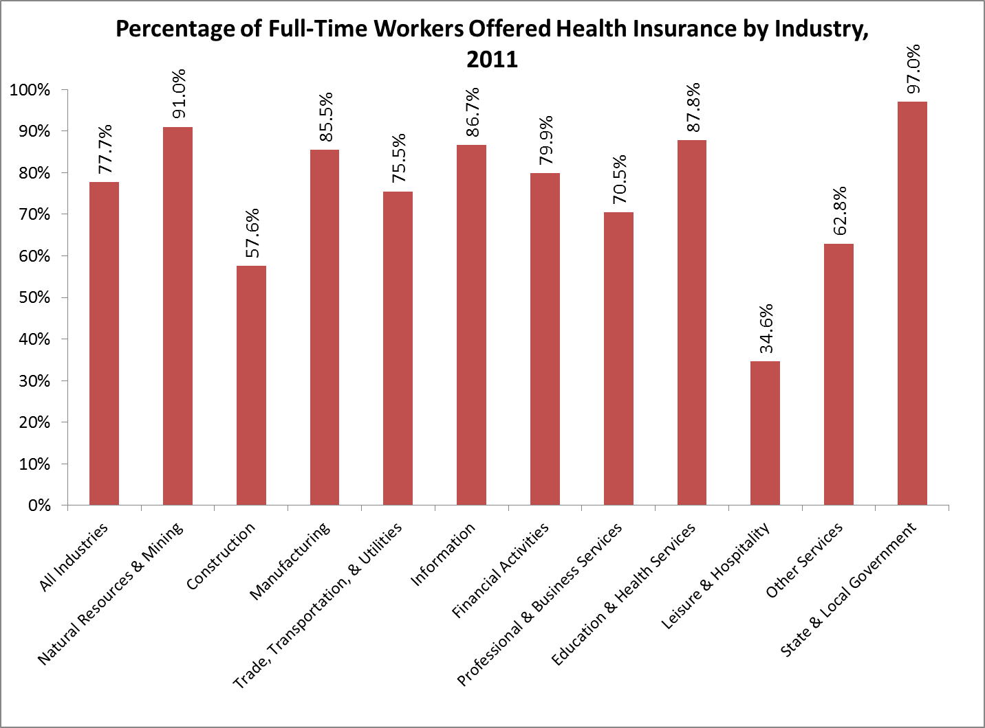
Health Insurance Provided by Industry

Slide 32
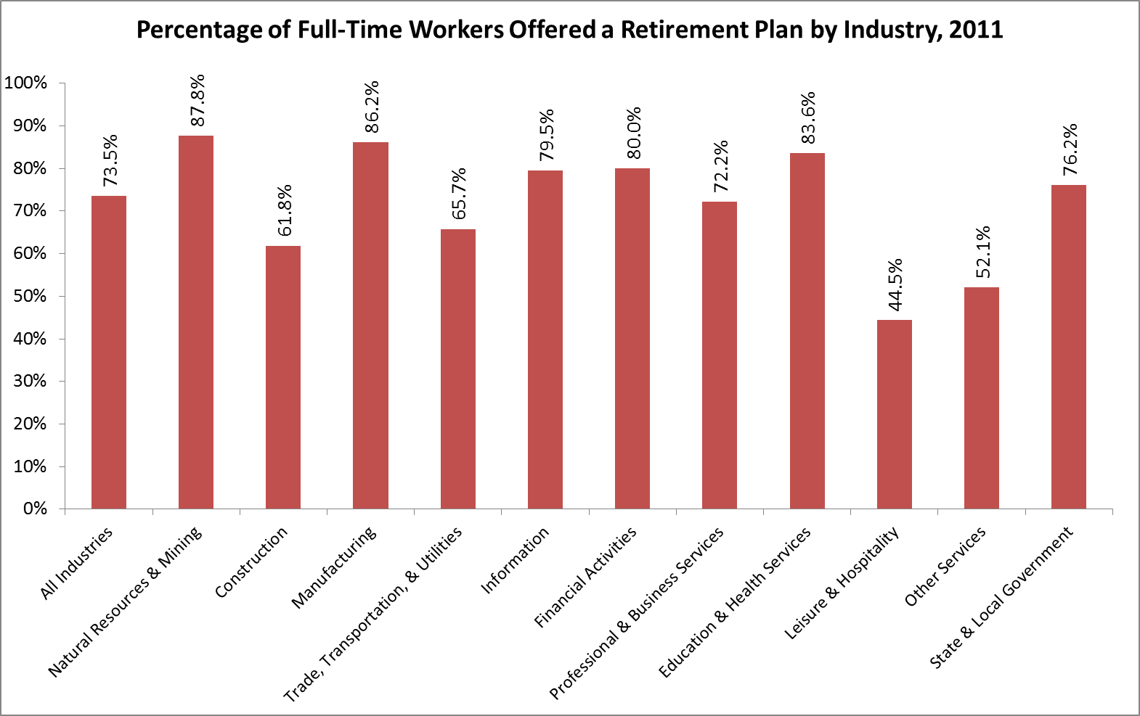
Retirement Plans Provided by Industry

Slide 33
Summary
A wide range of online resources are available to help facilitate career research.
Much of what was presented can be applied to occupations which require a Bachelor’s degree or higher.
Occupational and industry projections, although useful, are not without caveats.
Future employees ought to consider not only wages, but other factors, such as working conditions, when researching careers.
Employer-provided benefits are often not meaningful for people coming right out of high school, but they will matter more to them as they age.

Slide 34

Contact Research & Planning
Please feel free to contact us if you need help finding or understanding occupational or other labor market information.
Phone: 307-473-3807
Website: http://doe.state.wy.us/lmi/
E-Mail: DWS-RESEARCHPLANNING@wyo.gov
Mailing Address:
P.O. Box 2760
Casper, WY 82602

