Slide 1
Women in Wyoming’s Labor Market
Presented to the Wyoming Workforce Development Council on January 15, 2026,
and to the Wyoming Council for Women on January 20, 2026, by Michael Moore,
R&P Research Supervisor
Notes:
Good afternoon, my name is Michael Moore and I am the research supervisor for R&P.
Thank you for giving me the time today to talk to about women in Wyoming’s labor market.
I presented this information to the Wyoming Workforce Development Council last week, and it generated quite a bit of discussion. I image that will be the same tonight.

Slide 2
Women in Wyoming’s Labor Market
About Research & Planning
OUR ORGANIZATION:
R&P is an exclusively statistical entity within DWS.
WHAT WE DO:
R&P collects, analyzes, and publishes timely and
accurate labor market information (LMI)
meeting established statistical standards.
OUR CUSTOMERS:
LMI makes the labor market more efficient by
providing the public and the public’s
representatives with the basis for
informed decision making.
Notes:
Just a little bit about Research & Planning to get us started.
R&P is an exclusively statistical entity within DWS.
We collect, analyze and publish timely labor market information (LMI) data.
We provide this information to the public, legislators, educators, training providers, the media, and more.

Slide 3
Women in Wyoming’s Labor Market
Overview
Introduction
Gender Wage Gap
Recent Trends
Notes:
I’ve divided this presentation into three parts.
I’ll start with an introduction looking at as many different aspects of women in Wyoming’s workforce as we have available.
The second will look at Wyoming’s gender wage gap.
And finally, I’ll wrap up with a look at some recent trends.

Slide 4
Women in Wyoming’s Labor Market
Part 1: Introduction
Notes:
I will start things off with an introduction, presenting a wide overview of women in Wyoming’s workforce.

Slide 5
Women in Wyoming’s Labor Market
Introduction
Wyoming Population Estimates by Sex, 2024
Wyoming Population Estimates by Sex, 2024
Sex | N | % | Average Age
Female | 287,054 | 48.9 | 40.4
Male | 300,564 | 51.1 | 39.4
Total | 587,618 | 100.0 | 39.9
Source: U.S. Census Bureau, Population Division.
Prepared by M. Moore, Research & Planning, WY DWS, 11/25/25.
Source: U.S. Census Bureau.
Notes:
To begin we’ll look at 2024 population estimates for Wyoming from the U.S. Census Bureau.
There were an estimated 287,054 females living in Wyoming in 2024, a little bit lower than the estimated 300,564 males.
Females made up 48.9% of the population, while males made up 51.1%.
On average, females were a little bit older than males. The average age was 40.4 for females and 39.4 for males.

Slide 6
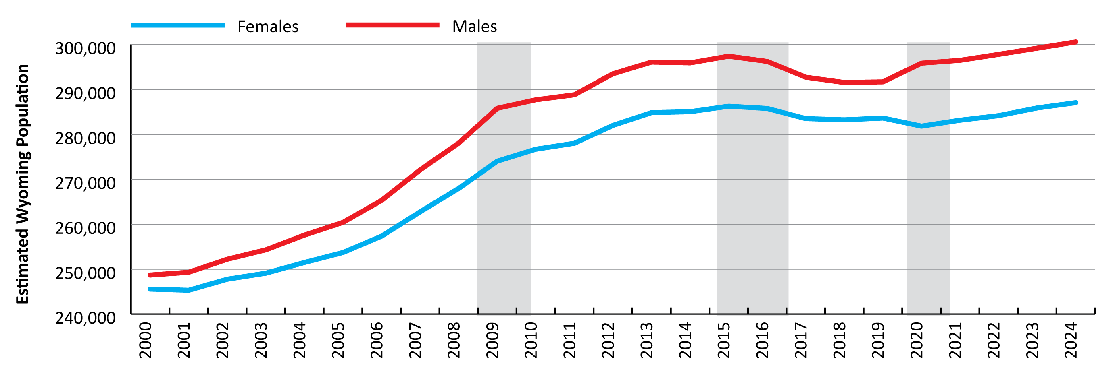
Women in Wyoming’s Labor Market
Introduction
Wyoming Population Estimates by Sex, 2000-2024
Source: U.S. Census Bureau.
Notes:
Looking at population estimates dating back to 2000, females and males have historically accounted for similar proportions of the population as they did in 2024.
Wyoming’s population grew pretty consistently from 2000 to 2015, but then saw a little bit of a consistent decrease from 2015 to 2019, especially among males. You can see this in the second shaded box.
This is likely due to the state of the economy at the time. In 2015 and 2016, Wyoming lost a lot of jobs in natural resources & mining, particularly in coal mining. During those years, all of our surrounding states saw pretty substantial economic growth. So it seems likely that individuals who lost their jobs in Wyoming were able to pick up and move and find employment in one of our surrounding states.
It’s interesting to note that we saw an increase in the male population from 2019 to 2020, while the female population declined slightly. But since then we’ve seen steady, consistent growth for both males and females.

Slide 7
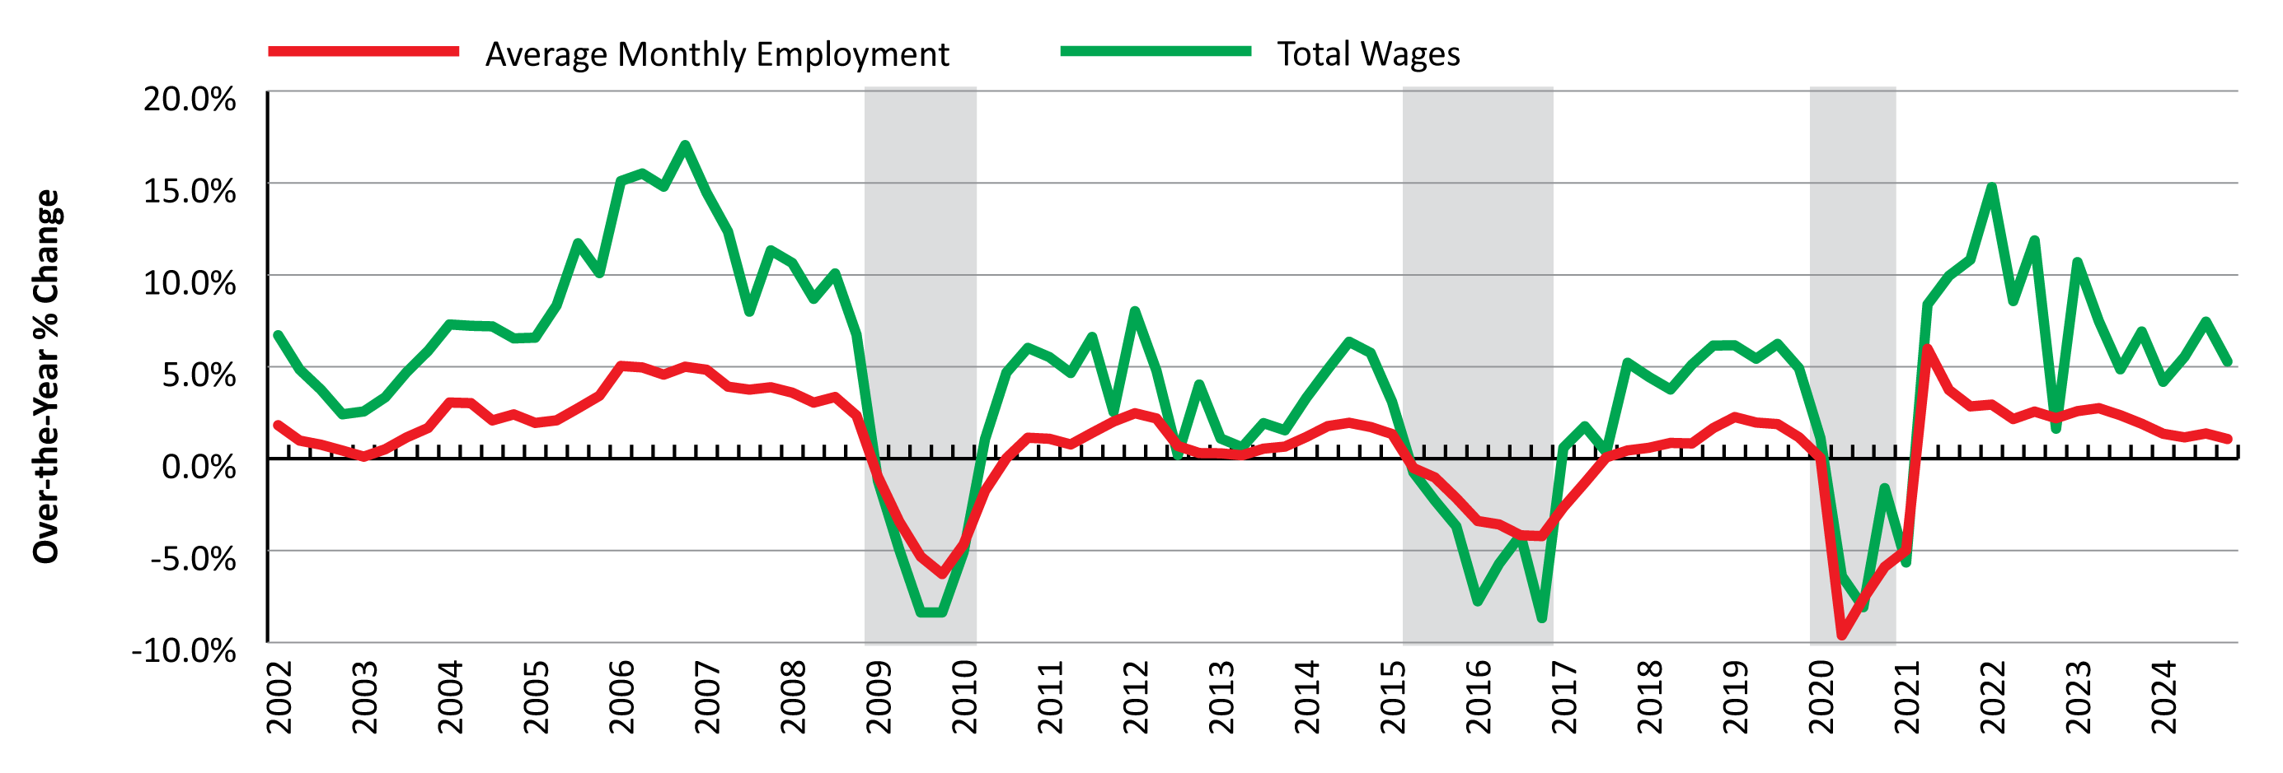
Women in Wyoming’s Labor Market
Introduction
Over-the-Year Percent Change in Employment and Wages
Source: Quarterly Census of Employment and Wages (QCEW).
Notes:
Really quick before we go any further, I want to talk about economic downturns in Wyoming, which you will see on several slides throughout this presentation.
I’ll go ahead and explain what we mean by economic downturn and give some context.
We define an economic downturn as at least two consecutive quarters of over-the-year decreases in both average monthly employment and total wages based on data from the Quarterly Census of Employment and Wages, or QCEW.
Many of the figures in this presentation have three shaded areas, and each of those represents an economic downturn.
Wyoming has had three economic downturns over the last 15 years or so. Each downturn had its own unique characteristics, but all three were also preceded by declining energy prices.

Slide 8
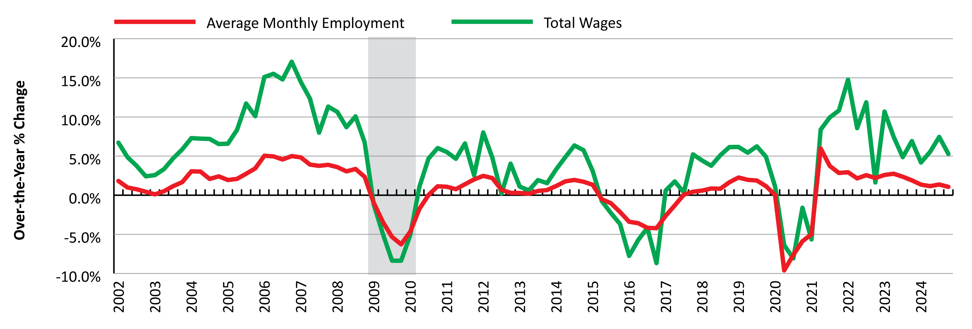
Women in Wyoming’s Labor Market
Introduction
Over-the-Year Percent Change in Employment and Wages
Source: Quarterly Census of Employment and Wages (QCEW).
Notes:
The first of these downturns lasted from first quarter 2009 to first quarter 2010 and coincided with the national great recession.

Slide 9
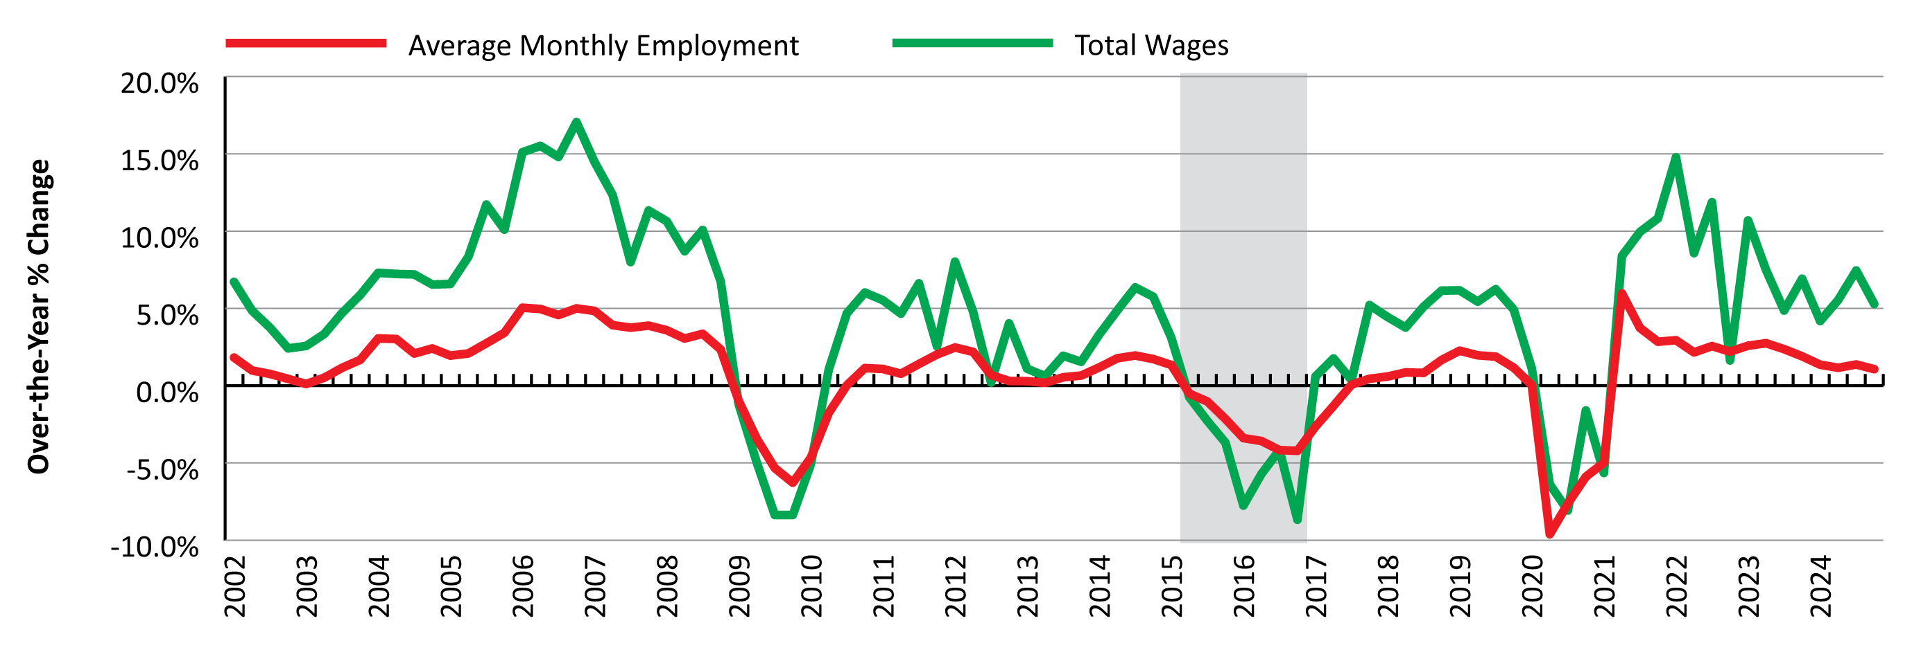
Women in Wyoming’s Labor Market
Introduction
Over-the-Year Percent Change in Employment and Wages
Source: Quarterly Census of Employment and Wages (QCEW).
Notes:
The second downturn was really driven by substantial job losses in coal mining and the oil & gas sectors, and affected Wyoming much more than other states. It lasted from second quarter 2015 to fourth quarter 2016.

Slide 10
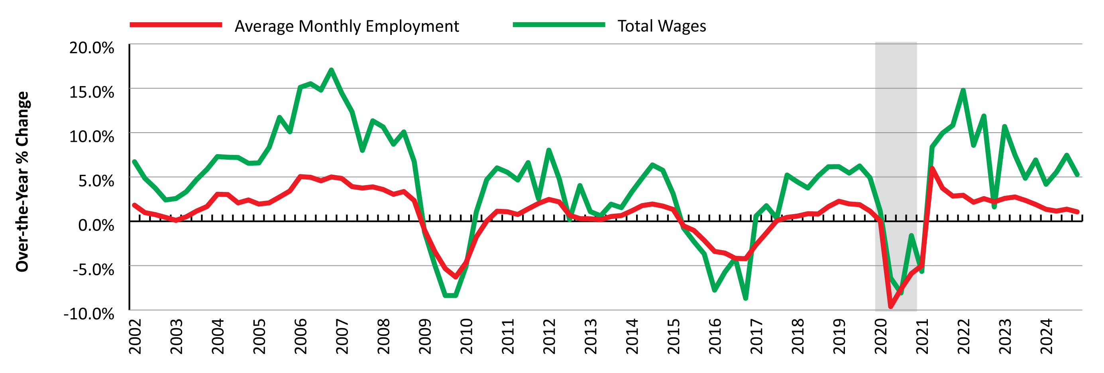
Women in Wyoming’s Labor Market
Introduction
Over-the-Year Percent Change in Employment and Wages
Source: Quarterly Census of Employment and Wages (QCEW).
Notes:
The third downturn lasted from second quarter 2020 to first quarter 2021, with the Covid-19 pandemic as a major contributor.

Slide 11
Women in Wyoming’s Labor Market
Introduction
Over-the-Year Percent Change in Employment and Wages
Source: Quarterly Census of Employment and Wages (QCEW).
Notes:
So again, all together, three economic downturns in the last 15 years or so.
And while each had its own unique characteristics, they were all preceded by declining energy prices.

Slide 12
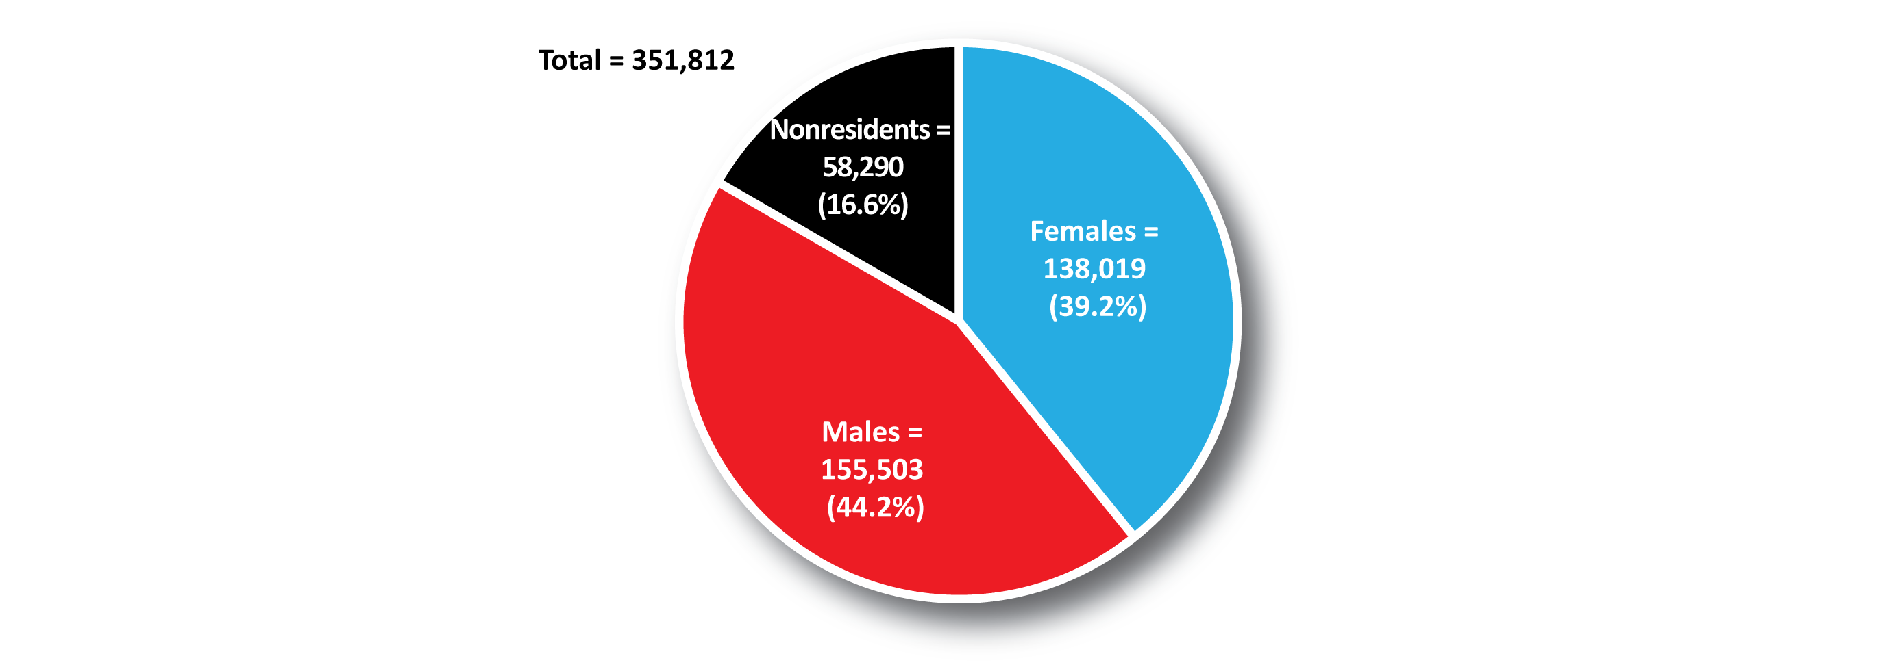
Women in Wyoming’s Labor Market
Introduction
Persons Working in Wyoming by Sex, 2024
Source: Demographics of the Workforce, Research & Planning, WY DWS.
Notes:
Moving on, we’ll look at the total number of persons working in Wyoming at any time during the year. These people may have worked one day, or all four quarters.
In 2024, there were 351,812 unique individuals working in Wyoming.
Females made up 39.2%, while males made up 44.2%.
The remaining 16.6% were nonresidents. These are people for whom we do not have demographic data.
Nonresidents are typically people who come to Wyoming for seasonal work in industries like construction and leisure & hospitality, or people who commute to Wyoming from another state. This could include telework.

Slide 13
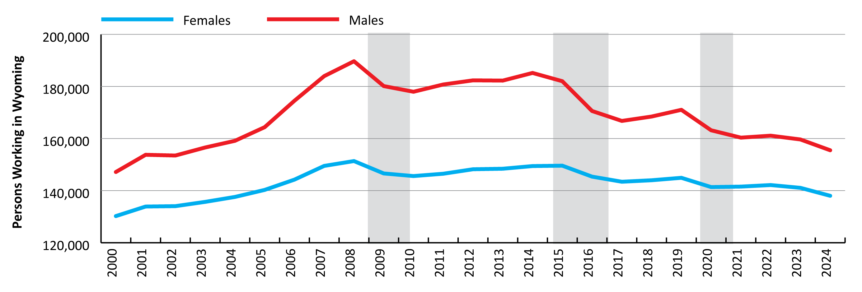
Women in Wyoming’s Labor Market
Introduction
Persons Working in Wyoming by Sex, 2000-2024
Source: Demographics of the Workforce, Research & Planning, WY DWS.
Notes:
This figure shows the number of males and females working in Wyoming at any time during the year from 2000 to 2024.
You can see the ups and downs. In particular, during those periods of economic downturn we see noticeable decreases in the number of people working, especially among males.
Since the pandemic, the number of males and females working in Wyoming has been pretty steady.

Slide 14
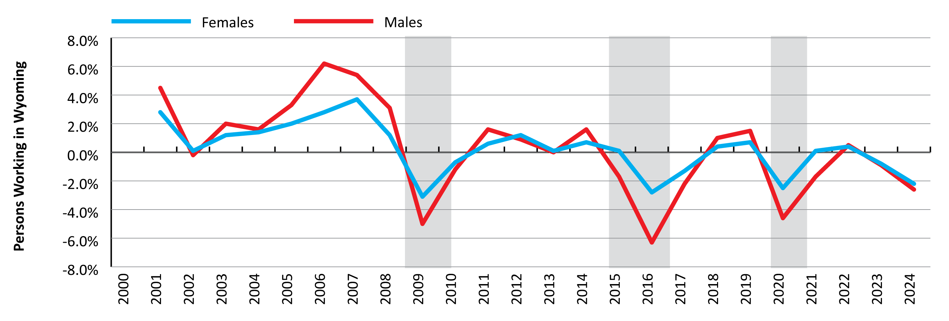
Women in Wyoming’s Labor Market
Introduction
Over-the-Year % Change in Persons Working in Wyoming by Sex, 2000-2024
Source: Demographics of the Workforce, Research & Planning, WY DWS.
Notes:
This figure presents a different way to look at the previous slide, and shows the over-the-year percent change in persons working in Wyoming by sex.
You can see how we had continued growth up until 2008, and since then we’ve had a series of ups and downs.
You can really see the job losses during those economic downturns in this graphic.

Slide 15
Youth in Wyoming and its Labor Market
Introduction
Females Working in Wyoming in 2024
Health Care & Social Assistance, 21.9%
Educational Services, 15.8%
Leisure & Hospitality, 15.6%
Retail Trade, 12.6%
Professional & Business Services, 8.0%
Source: Demographics of the Workforce, Research & Planning, WY DWS.
Notes:
This slide shows the top industries of employment for females working in Wyoming in 2024.
The largest number of females worked in industries like health care & social assistance, educational services, and professional & business services.

Slide 16
Youth in Wyoming and its Labor Market
Introduction
Males Working in Wyoming in 2024
Construction, 14.1%
Leisure & Hospitality, 11.5%
Natural Resources & Mining, 11.3%
Retail Trade, 11.2%
Wholesale Trade, Transportation, & Utilities, 10.8%
Source: Demographics of the Workforce, Research & Planning, WY DWS.
Notes:
In contrast, the largest number of males worked in industries like construction, natural resources & mining, and wholesale trade, transportation, & utilities.
A large number of both sexes also work in lower-paying industries like leisure & hospitality and retail trade.

Slide 17
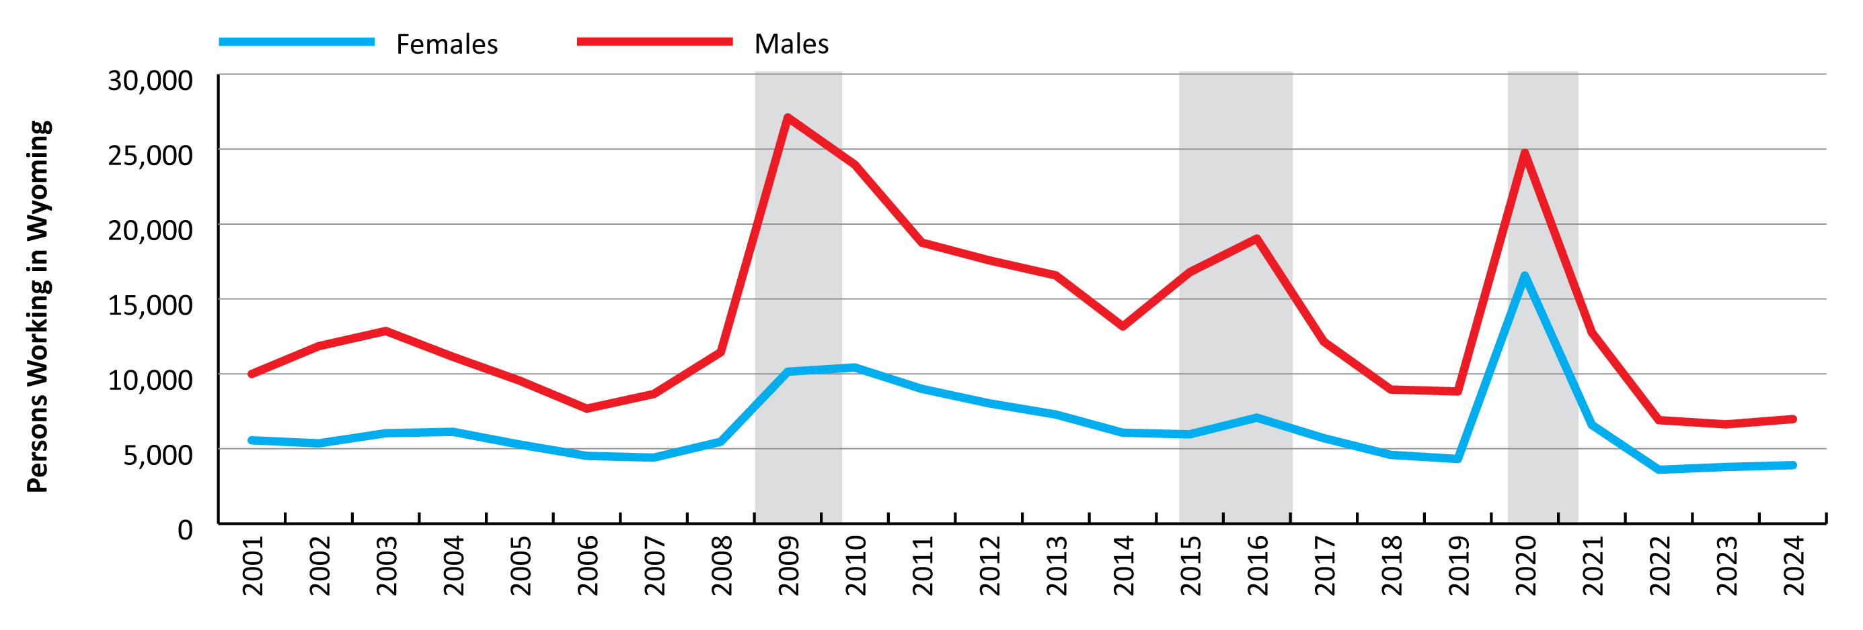
Women in Wyoming’s Labor Market
Introduction
Unemployment Insurance (UI) Benefit Recipients by Sex, 2001-2024
Source: Unemployment Insurance (UI) claims data, Research & Planning, WY DWS.
Notes:
Moving on, this figure shows the number of Unemployment Insurance benefit recipients in Wyoming by sex from 2001 to 2024.
Once again the red line represents males, and the blue line represents females.
You can see that in every year for which we have data, more males received UI benefits than females.
When we look at periods of economic downturn, we see a big spike of males receiving benefits in 2009/10 and 2015/16, while the increase in females receiving benefits was more modest.
The 2020-2021 downturn was a little different, as we also saw a big spike in females receiving UI benefits. This is due in large part to the substantial increase in claims in leisure & hospitality, which typically has a large number of both male and female workers.
Part of the reason we see more men receiving UI benefits is the types of the jobs worked and the industries those jobs are found in. During most years construction accounts for a third or more of all UI claims, and those are jobs mostly worked by males.

Slide 18
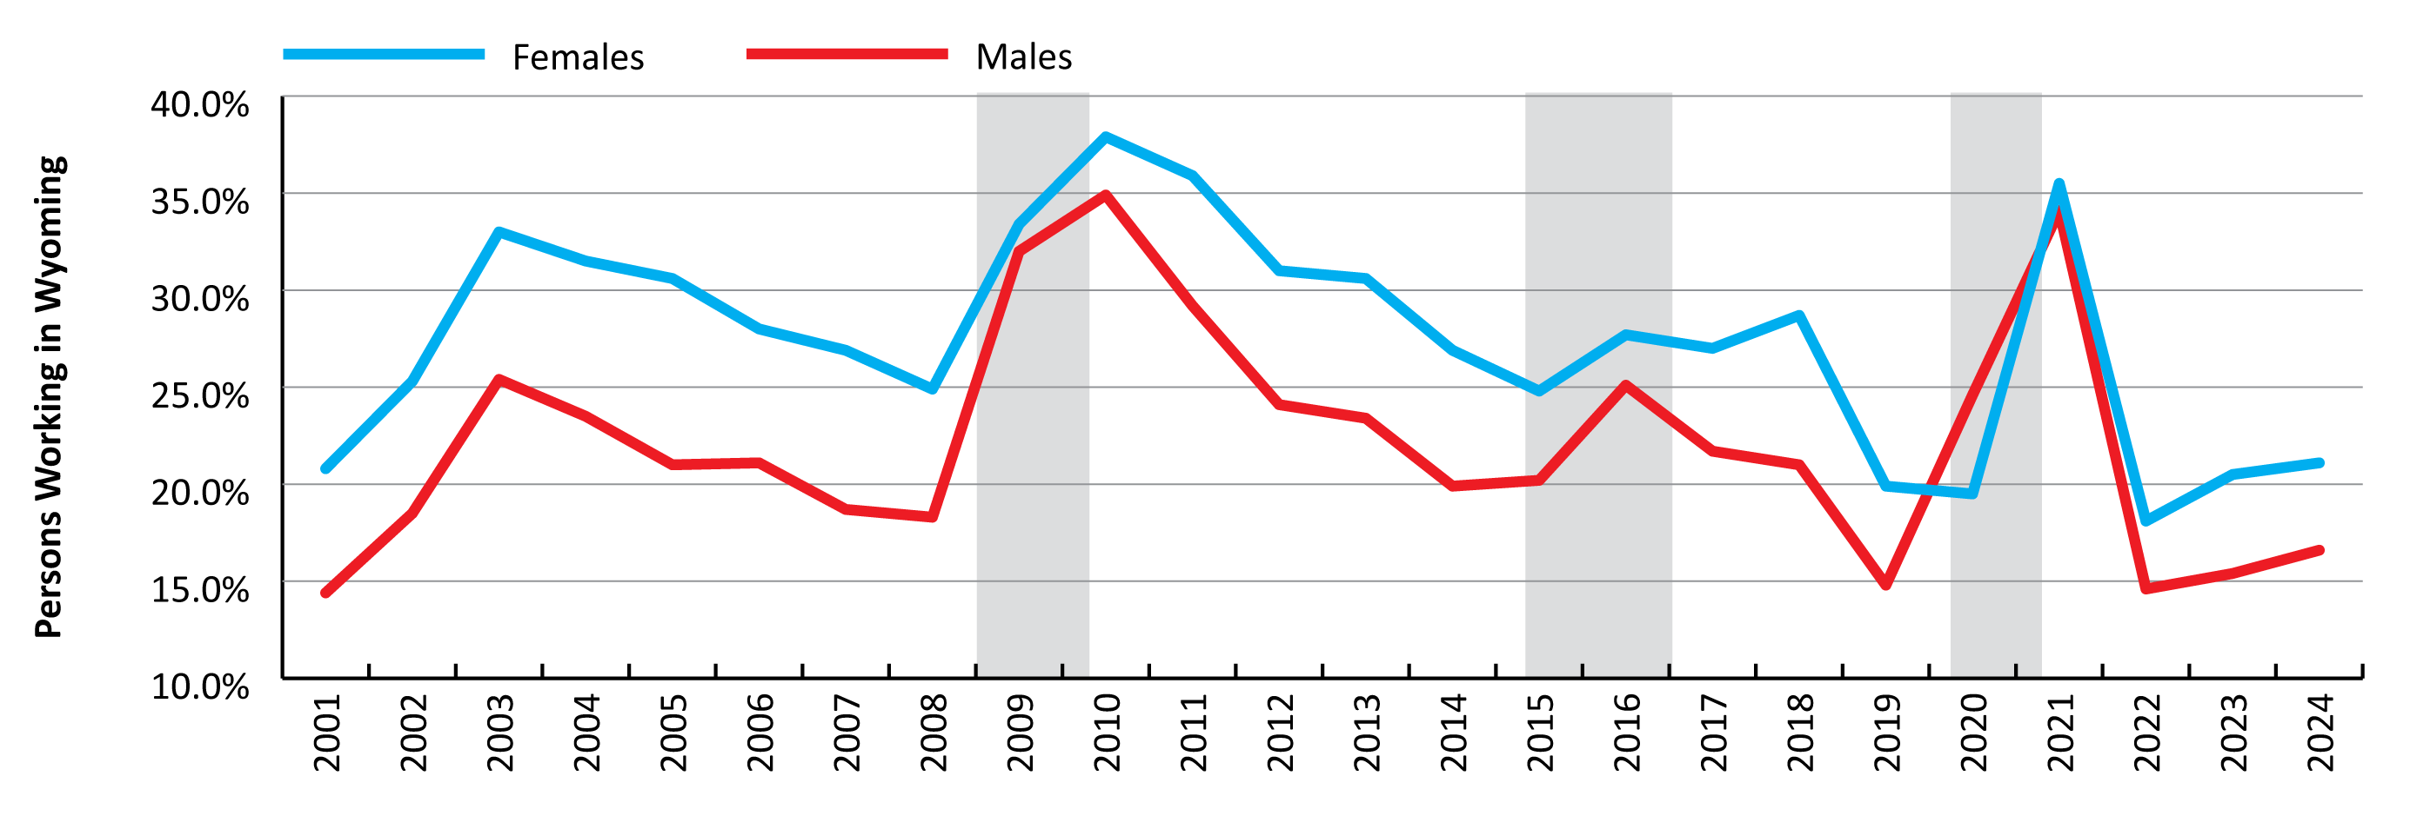
Women in Wyoming’s Labor Market
Introduction
Unemployment Insurance (UI) Exhaustion Rate by Sex, 2001-2024
Source: Unemployment Insurance (UI) claims data, Research & Planning, WY DWS.
Notes:
This next slide shows the percent of benefit recipients who exhausted their benefits by sex from 2001 to 2024.
Almost without exception, females are more likely to exhaust their benefits than males. The one exception for this was 2020, when a slightly higher proportion of males than females exhausted their benefits.
Most recently in 2024, 21.1% of females receiving UI benefits exhausted them, compared to 16.6% of males.
There are a lot of factors that figure into UI claims eligibility, such as the amount of time with an employer, pre-layoff wages, and more. This affects the duration of the benefits, the amount, and more.
My guess is that males receiving UI benefits often come from jobs in industries like construction, where they qualify for a longer of duration of benefits than females who worked in industries like leisure & hospitality or retail trade. The shorter the duration of benefits, the more likely it is that the claimant will exhaust those benefits.
This is certainly a topic we could dig into further if there is any interest.

Slide 19
Women in Wyoming’s Labor Market
Introduction
Labor Force Participation Rates by Sex, 2024
Labor Force Participation Rates by Sex for Wyoming and the U.S., 2024
Sex | Wyoming | U.S.
Female | 58.3 | 57.5
Male | 68.6 | 68.0
Total | 63.5 | 62.6
Source: U.S. Bureau of Labor Statistics.
Prepared by M. Moore, Research & Planning, WY DWS, 1/6/26.
Notes:
We’ll look at the labor force participation rate by sex for Wyoming and the U.S.
The labor force participation rate is calculated by dividing the number of individuals in the labor force by the total working age population.
The labor force is defined as the non-institutionalized population (ages 16 and older) either currently employed or unemployed and actively seeking work. This excludes military personnel and individuals in institutions like prisons or nursing homes.
The labor force participation rate is considerably higher for males than females. In 2024, the average annual labor force participation rate for males in Wyoming was 68.6%, compared to 58.3% for females.
Wyoming has historically had a slightly higher labor force participation rate compared to the national average. The average labor force participation rate for the U.S. was 57.5% for females and 68.0% for males.

Slide 20
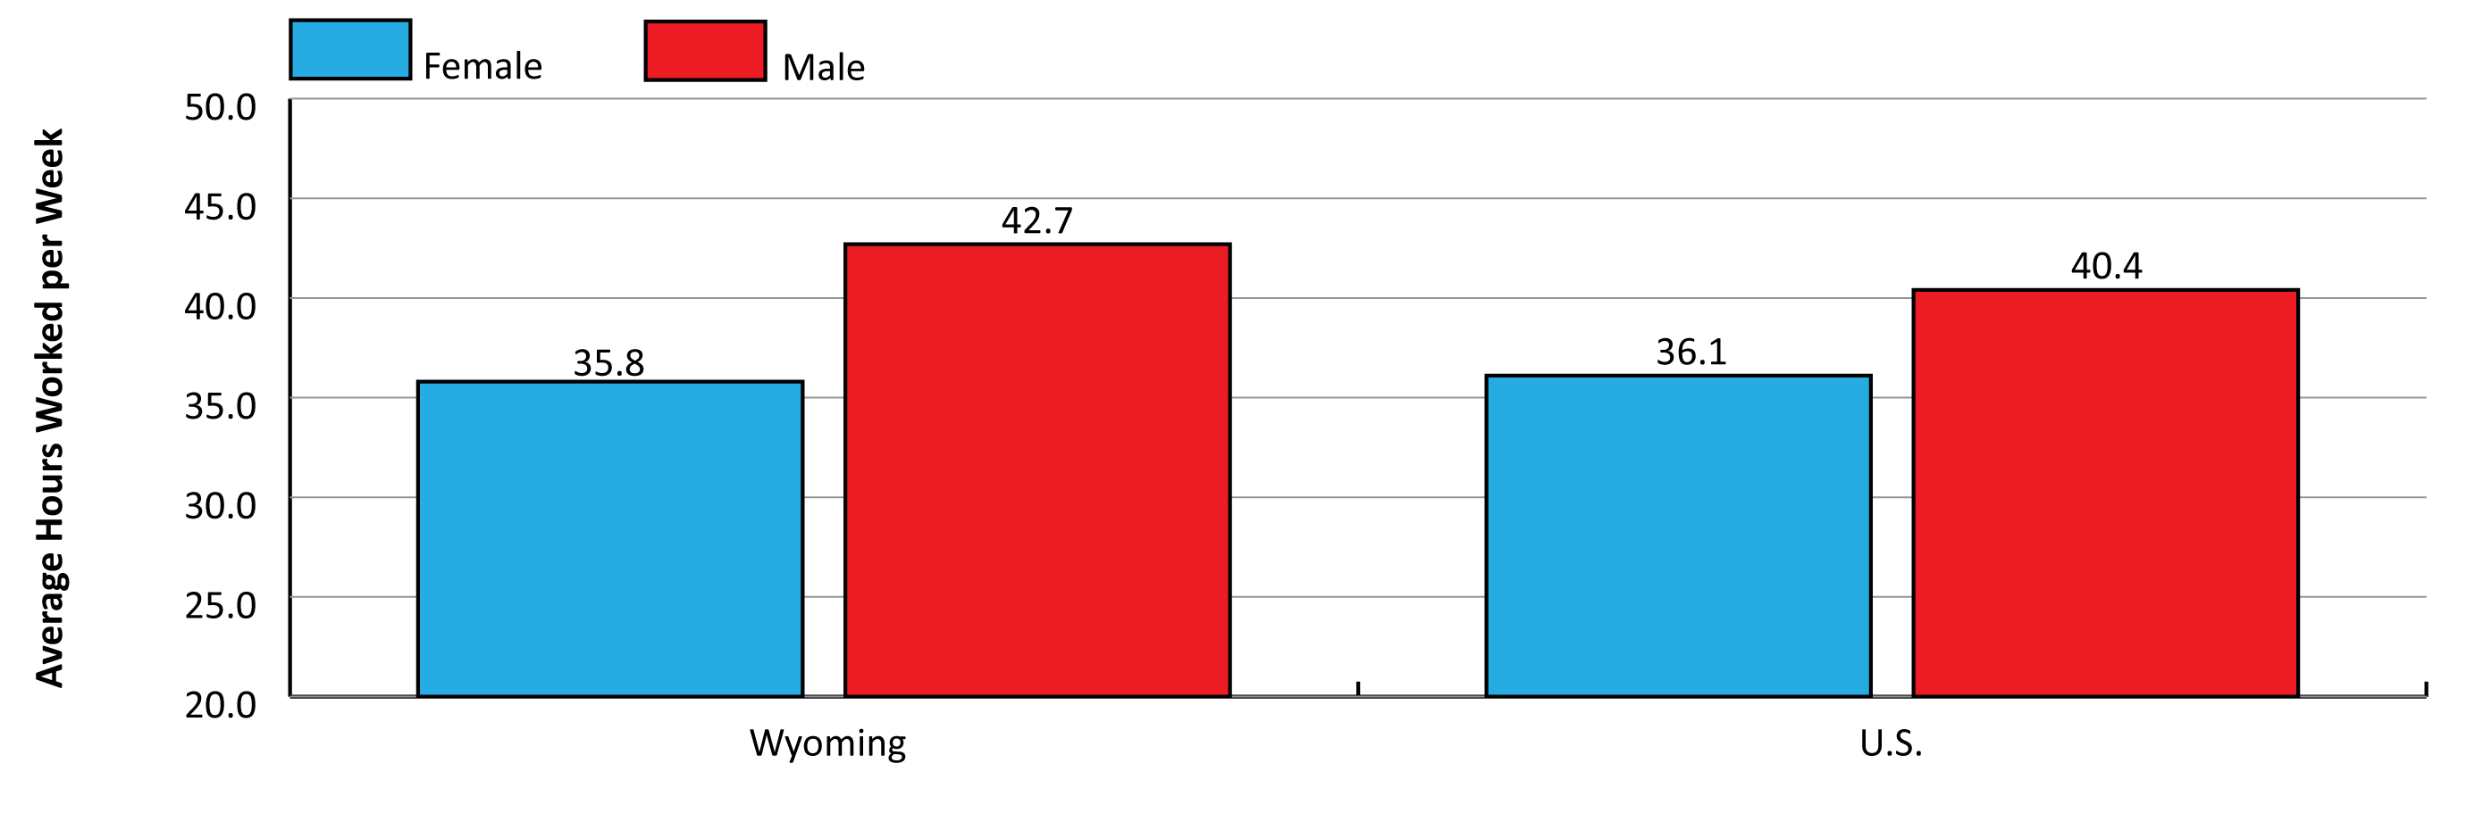
Women in Wyoming’s Labor Market
Introduction
Average Number of Hours Worked per Week by Sex, 2024
Source: American Community Survey 1-Year Estimates, U.S. Census Bureau.
Notes:
This figure shows the average number of hours worked for males and females in Wyoming and the U.S. in 2024.
According to these 1-year estimates from the American Community Survey, females ages 16-64 in Wyoming worked an average of 35.8 hours per week, compared to 42.7 for males.
In the U.S., females worked an average of 36.1 hours per week, compared to 40.4 hours per week for males.
So females in Wyoming worked fewer hours on average compared to the U.S., while males in Wyoming worked more.

Slide 21
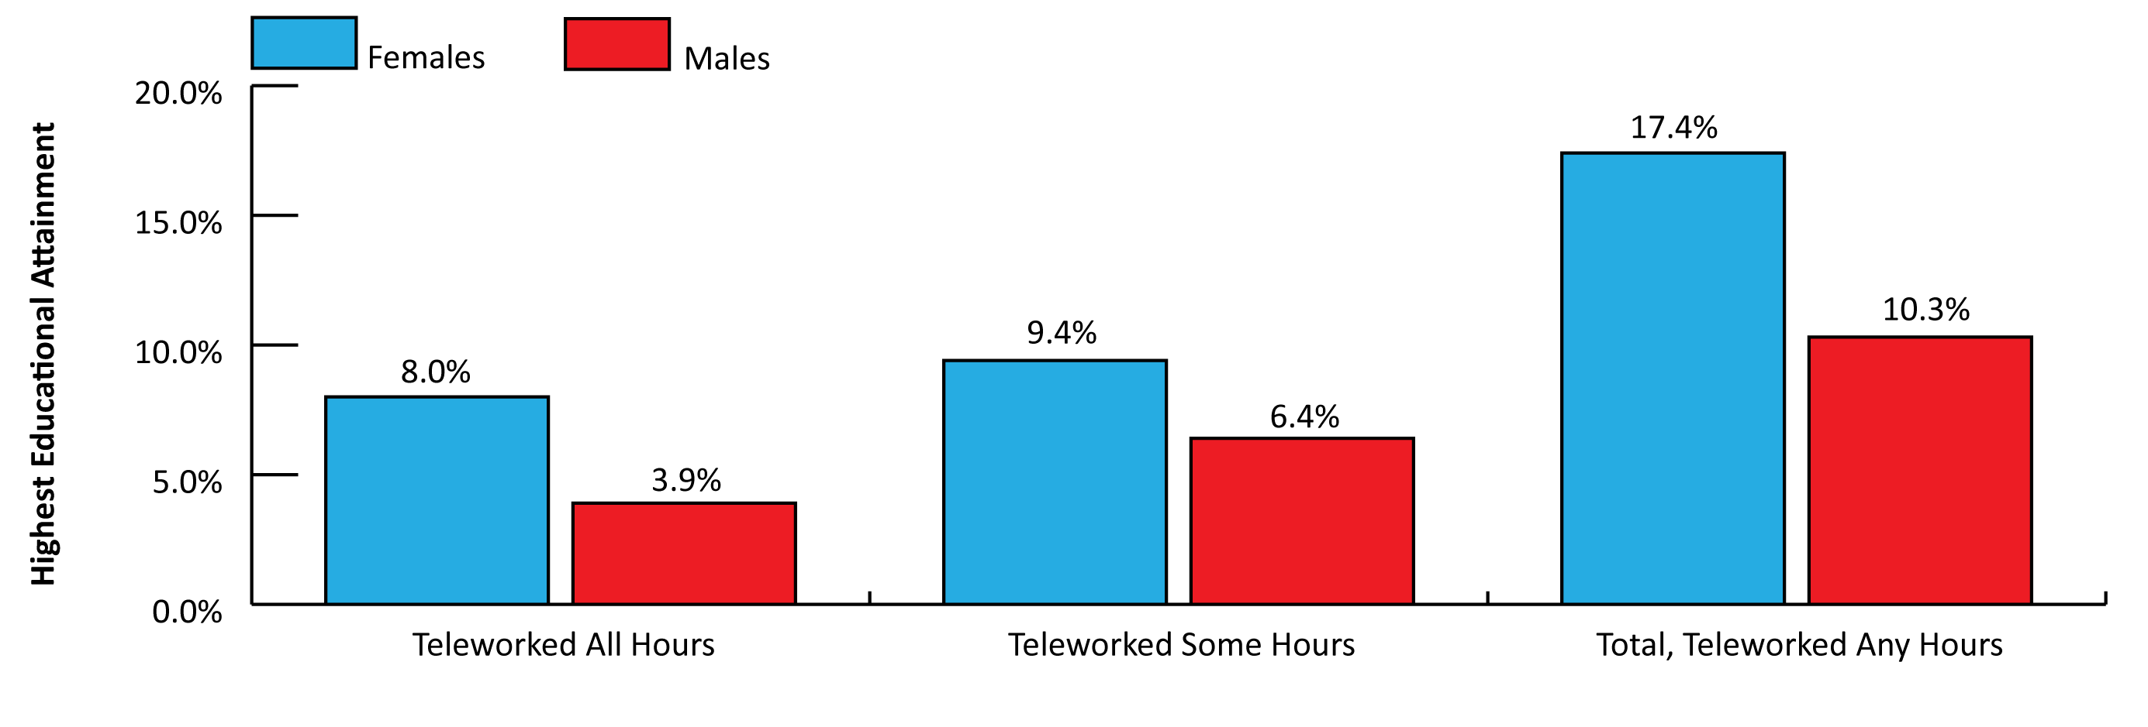
Women in Wyoming’s Labor Market
Introduction
Percent of Persons in Wyoming Teleworking by Sex, 2024
Source: American Community Survey, U.S. Census Bureau.
Notes:
For the last several years telework has been a hot topic, and one that the Bureau of Labor Statistics and state labor market information offices have struggled to quantify.
The Census Bureau does provide some data on telework through its American Community Survey, looking at how many individuals telework in a week.
This comes from a relatively small sample and doesn’t differentiate people teleworking for Wyoming employers vs. out-of-state employers, but it does give us some ideas.
In 2024, females were more likely to work in occupations that allow them to telework than males. This is probably due in large part to the types of jobs worked in Wyoming, with a large number of males working in jobs that won’t allow them to telework in industries like construction and mining.
8% of all females working in Wyoming teleworked all of their hours, compared to 3.9% of males.
9.4% of females teleworked some of their hours, compared to 6.4% of males.
In total, 17.4% of females teleworked any amount of hours in a week, compared to 10.3% of males.

Slide 22
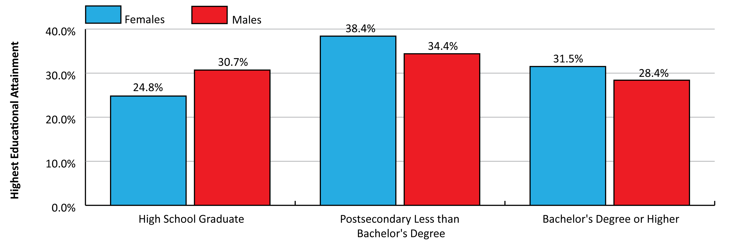
Women in Wyoming’s Labor Market
Introduction
Highest Completed Education by Sex in Wyoming, 2023
Source: American Community Survey, U.S. Census Bureau.
Notes:
This figure shows the highest completed education by sex for Wyoming’s population.
24.8% of all females had a high school diploma (or equivalent) as their highest level of education, compared to 30.7% of males.
38.4% of females had an associate’s degree or some college, no degree, compared to 34.4% for males.
Finally, 31.5% of all females had a bachelor’s degree or higher, compared to 28.4% of males.
In general, females in Wyoming tended to have a higher level of education than males.

Slide 23
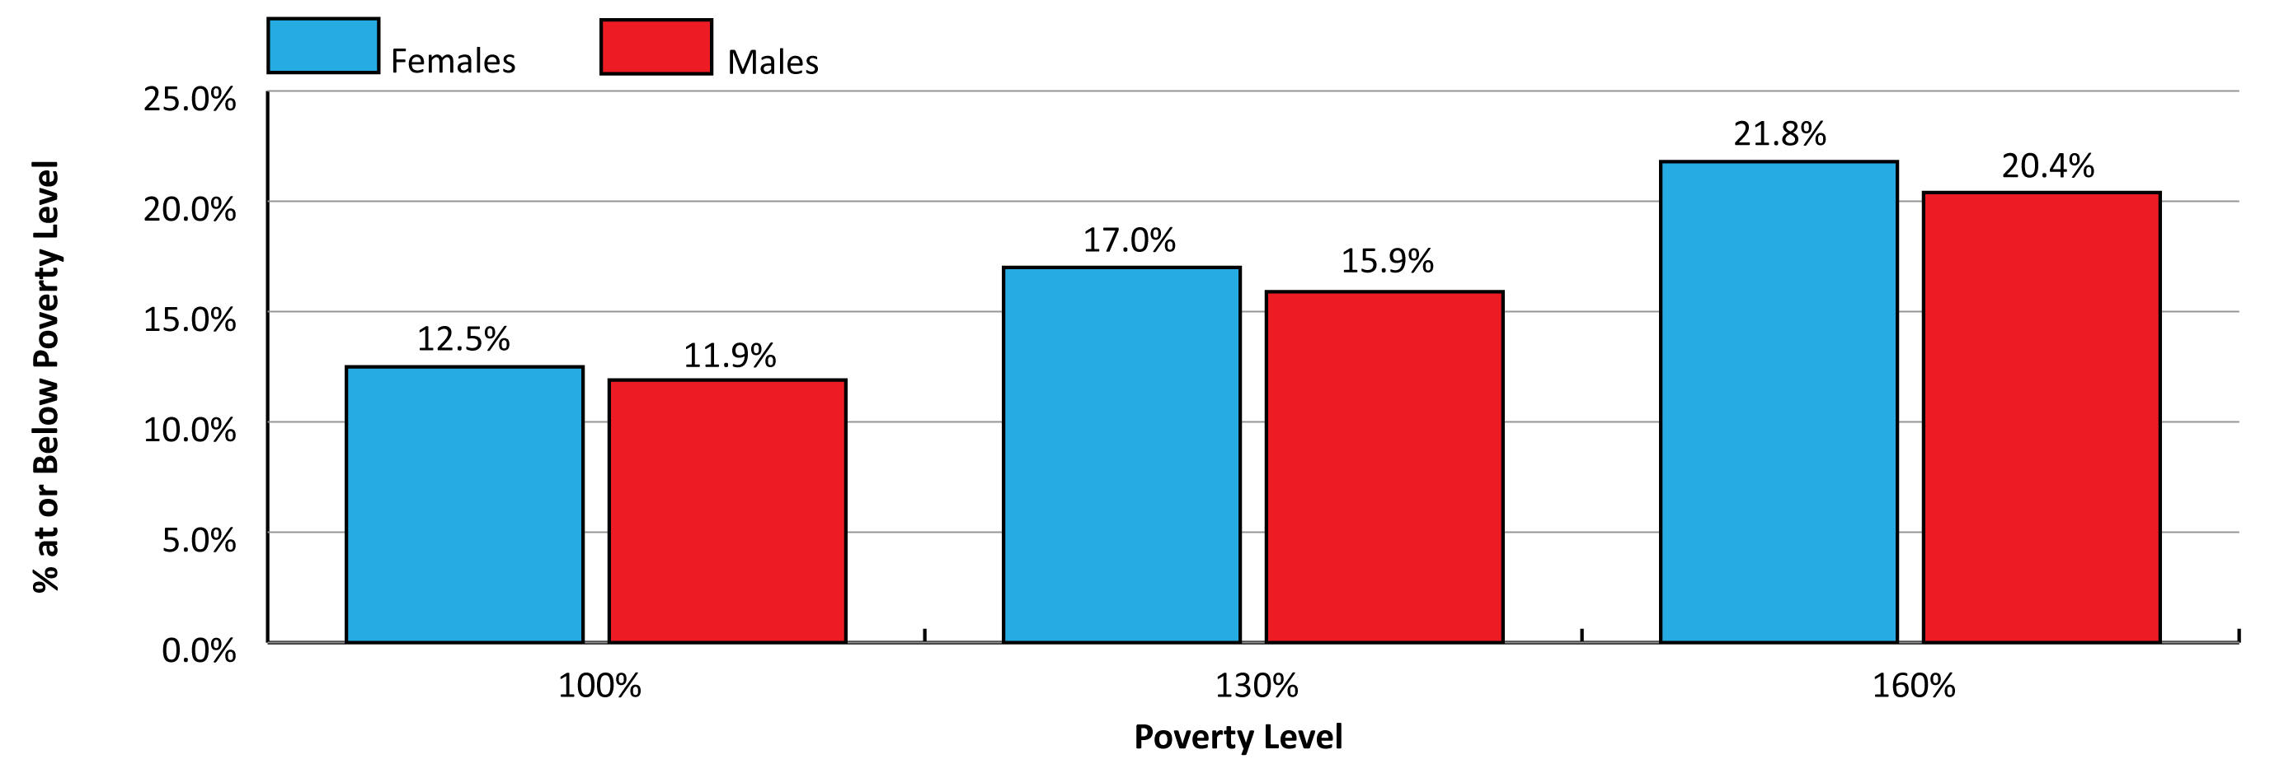
Women in Wyoming’s Labor Market
Introduction
Percent of Individuals at or Below Poverty Level by Sex, 2023
Source: American Community Survey, U.S. Census Bureau.
Notes:
This figure shows the percent of individuals at or below the poverty level in Wyoming in 2023.
For 2023, the Federal Poverty Guideline (FPL) in the contiguous U.S. was $14,580 for one person and $30,000 for a family of four.
A larger percentage of females tended to be at or below the poverty line than males.
For example, 12.5% of females were at or below the poverty line, compared to 11.9% of males.
When we increase that to 130% of the poverty level, the percentage of women increased to 17.0%, compared to 15.9% for males.
Finally, when we look at 160% of the poverty level, 21.8% of all females were at or below this level, compared to 20.4% of males.

Slide 24
Women in Wyoming’s Labor Market
Part 2: Gender Wage Gap
Notes:
I will move on to talking about Wyoming’s gender wage gap.

Slide 25
Women in Wyoming’s Labor Market
Gender Wage Gap
Reasons for the Gender Wage Gap
Industry of employment
Type of job worked
Number of hours worked
Time with employer
Education
County
No statistical answer to a political question
Notes:
Before I get into this part of the presentation, I want to temper some expectations.
R&P has done a lot of work on the gender wage gap in Wyoming. We authored a very comprehensive publication in 2018 that included what is called a decomposition analysis, where we tried to help explain the factors that contribute to Wyoming’s gender wage gap.
These include things like industry of employment, type of job worked, number of hours worked, time with employer, education, and county of employment.
There are plenty of factors that are not statistical that are not appropriate for an agency like R&P, such as marital status, family dynamics, and lack of child care. These are best left up to Wyoming’s leaders and policymakers.
So please keep in mind that at the end of the day, a purely statistical entity like R&P isn’t the best option to answer these questions as to why this wage gap exists.

Slide 26
Women in Wyoming’s Labor Market
Gender Wage Gap
Limitations of the Data
Very little on occupation
Hard to compare apples to apples
Data we do have are for licensed occupations
These tend to skew toward female jobs
Many in health care and educational services
Notes:
One of the challenges we face in looking at the factors of the gender wage gap is that we have very little data at the occupational level. These data comes from wage records, which are generated from employers’ quarterly UI tax filings. Wyoming collects data on the industry that person works in, but not the occupation in which they work. The only two states that do collect occupational data are Alaska and Nebraska.
Without data at the occupational level, it’s difficult to determine if females working in one occupation are earning the same as males in that same occupation.
We do have some occupational data through some data-sharing agreements, but most of those are accomplished by linking wage records to licensed occupation files from state licensing boards.
The majority of those occupations are in industries like health care & social assistance and educational services, and a larger proportion of the jobs in those industries tend to be worked by females.

Slide 27
Women in Wyoming’s Labor Market
Gender Wage Gap
2018 Study: Occupations
From 2005 to 2017, 87,000 total wage records met criteria
Average total wage records per quarter: more than 300,000
228 occupations (at least 5 females/5 males)
81 with significantly different wages
  76 - males earned more
  5 - females earned more
Notes:
When we published our study in 2018, we were able to identify about 87,000 wage records that met the parameter of the study that we could use to compare wages, and that was from 2005 to 2017. That may sound like a lot, but keep in mind that there are generally around 300,000 wage records for each quarter. That’s 13 years with 4 quarters per year, or 52 quarters. Multiply that by 300,000 and we’re talking about more than 15 million total wage records during that time.
Basically about .5% of all wages records during that time met the criteria
We identified 228 different occupations for which we had at least 5 males and 5 females in the same occupation. Within those, we found 81 where the wages were significantly different. Within those 81, males earned significantly more in 76, and females earned significantly more in just 5.

Slide 28
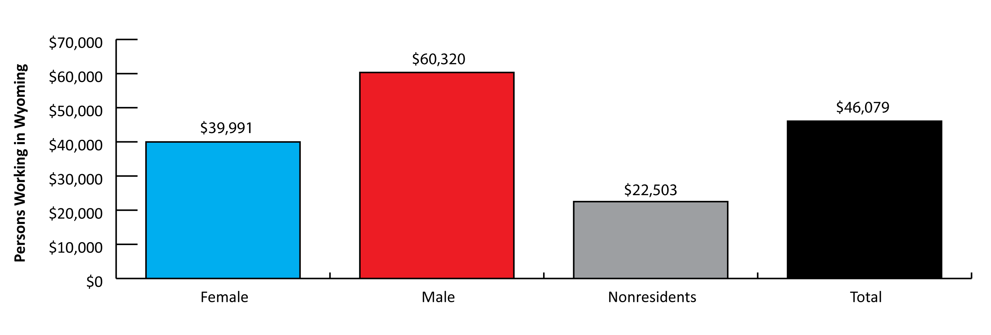
Women in Wyoming’s Labor Market
Gender Wage Gap
Average Annual Wage in Wyoming by Sex, 2024
Source: Demographics of the Workforce, Research & Planning, WY DWS.
Notes:
In 2024, the average annual wage in Wyoming for persons working any time during the year was $46,079.
Males earned considerably more at $60,320, while females earned less at $39,991.
Females earned 66.3% of what males earned, or 66.3 cents on the dollar.
There are a lot of factors that go into the wage gap, including the industries worked, the types of jobs worked, the number of hours worked, etc.

Slide 29
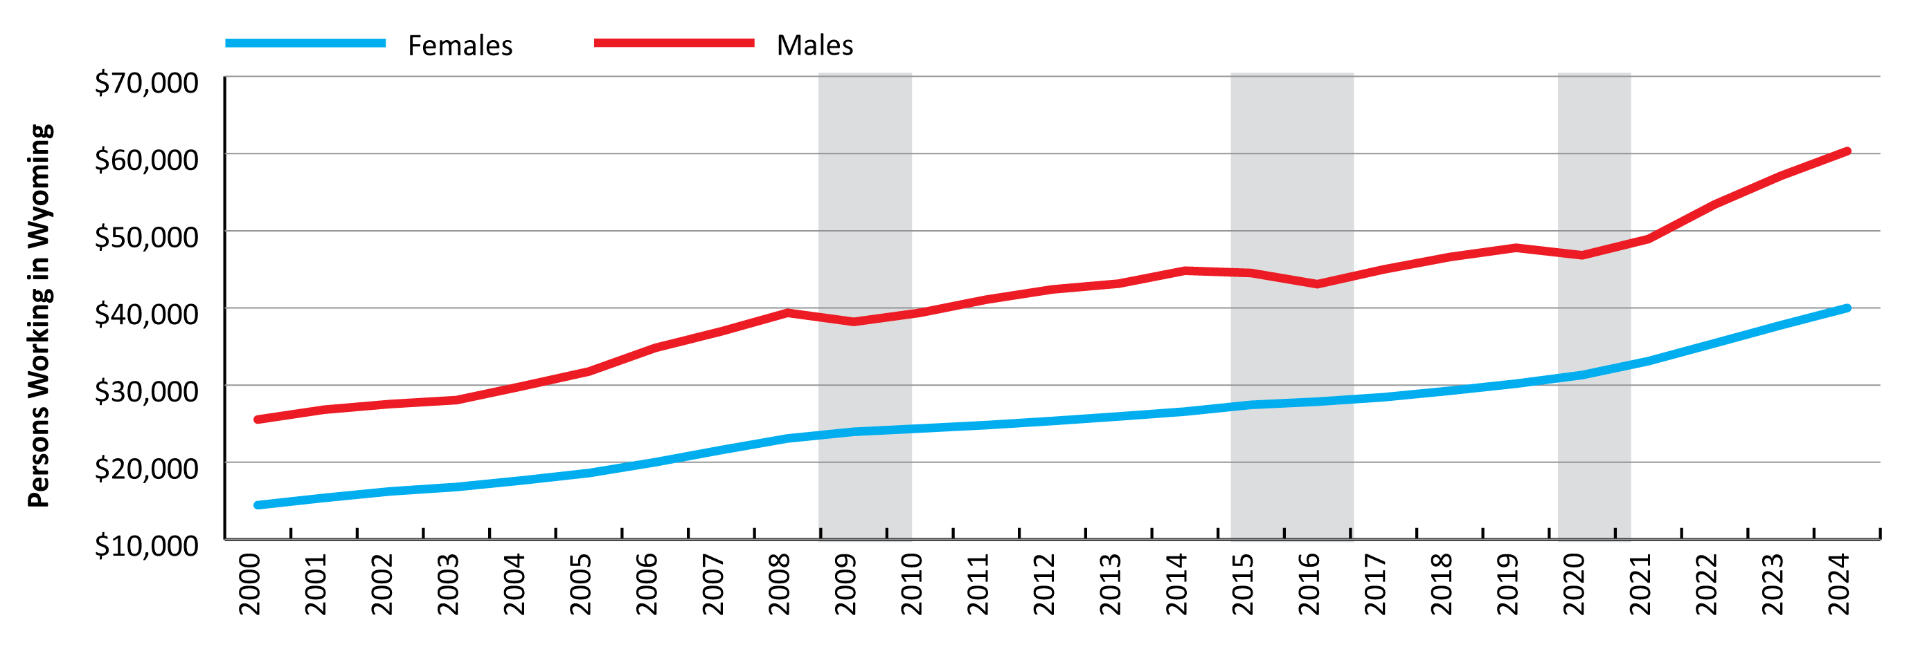
Women in Wyoming’s Labor Market
Gender Wage Gap
Average Annual Wage in Wyoming by Sex, 2000-2024
Source: Demographics of the Workforce, Research & Planning, WY DWS.
Notes:
This slide shows the average annual wage for persons working in Wyoming by sex from 2000 to 2024.
You can see that males have earned more than females in every year going back to 2000, especially during years of economic expansion, like 2006-2008.
Again when we look at those periods of economic downturn, males’ wages drop, while females’ wages do not.

Slide 30
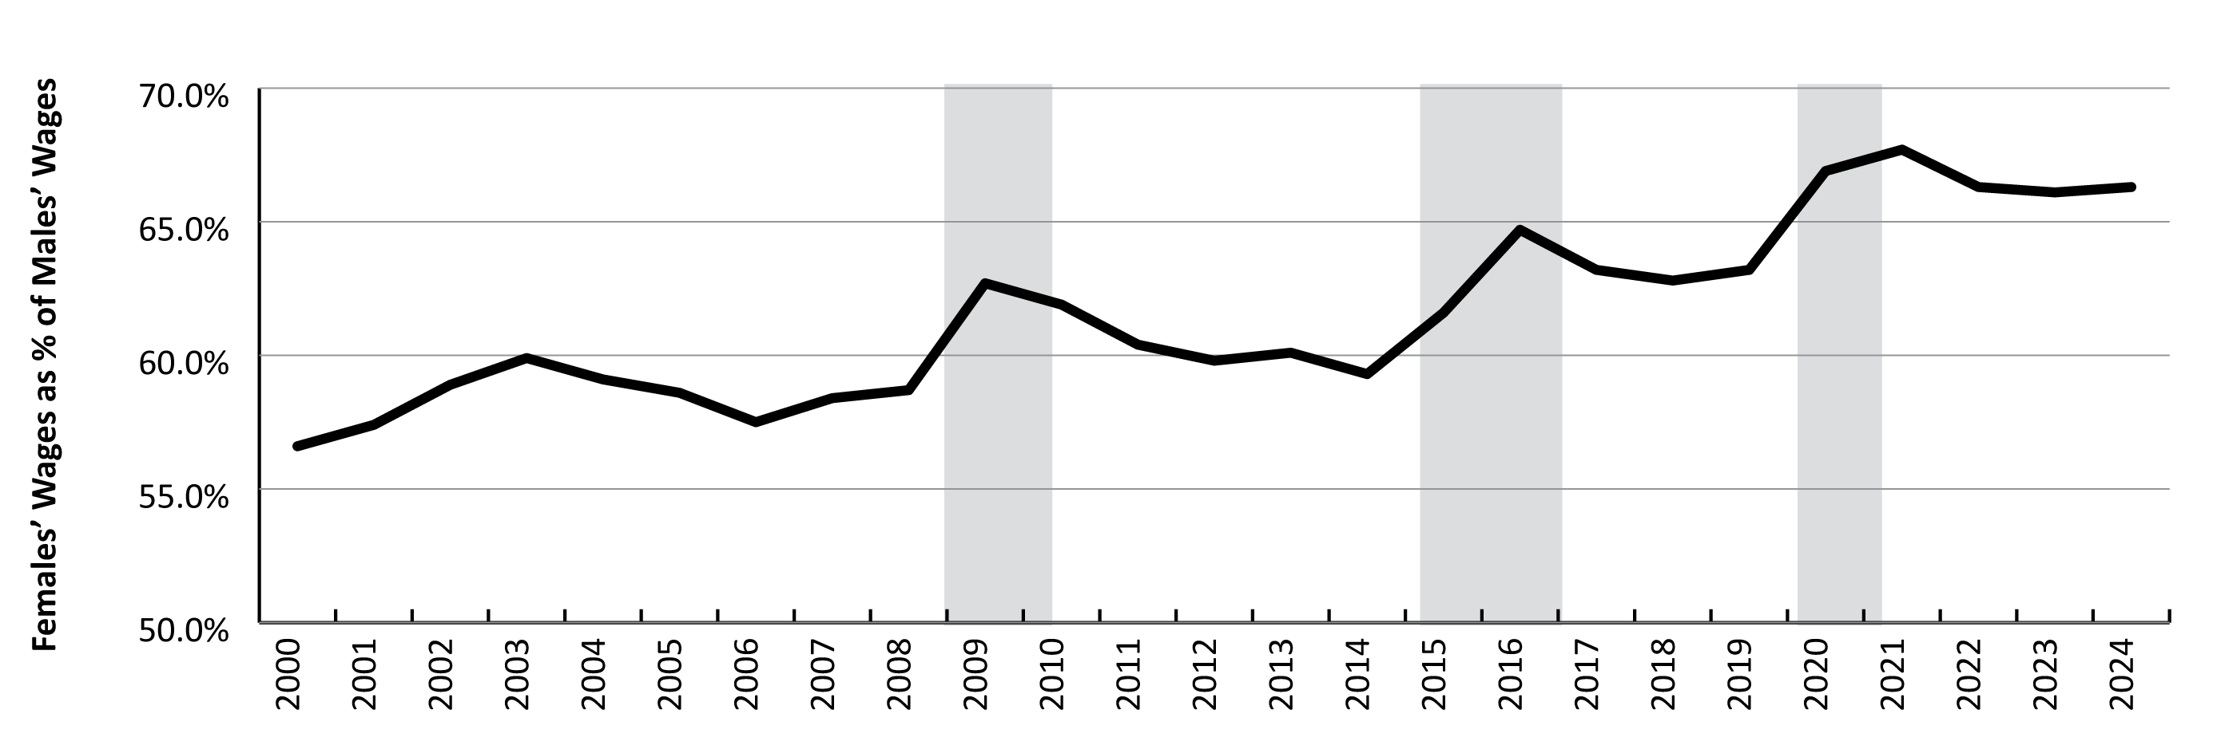
Women in Wyoming’s Labor Market
Gender Wage Gap
Females’ Wages as Percentage of Males’ Wages
Source: Demographics of the Workforce, Research & Planning, WY DWS.
Notes:
This graph shows females’ wages as a percent of males’ wages from 2000 to 2024.
You can see it was below 60% or (60 cents on the dollar) from 2004 to 2008, when we really had that boom in natural resources & mining.
You can see the trend of the wage gap narrowing (percentage increasing) during periods of economic downturn. When we lose a large number of high-paying mining jobs, the wage gap narrows.
We have seen an increase since 2019, usually at about 66 cents on the dollar. That’s not necessarily because wages for females have increased, but because we’ve continued to shed high-paying mining jobs that are typically worked by males.

Slide 31
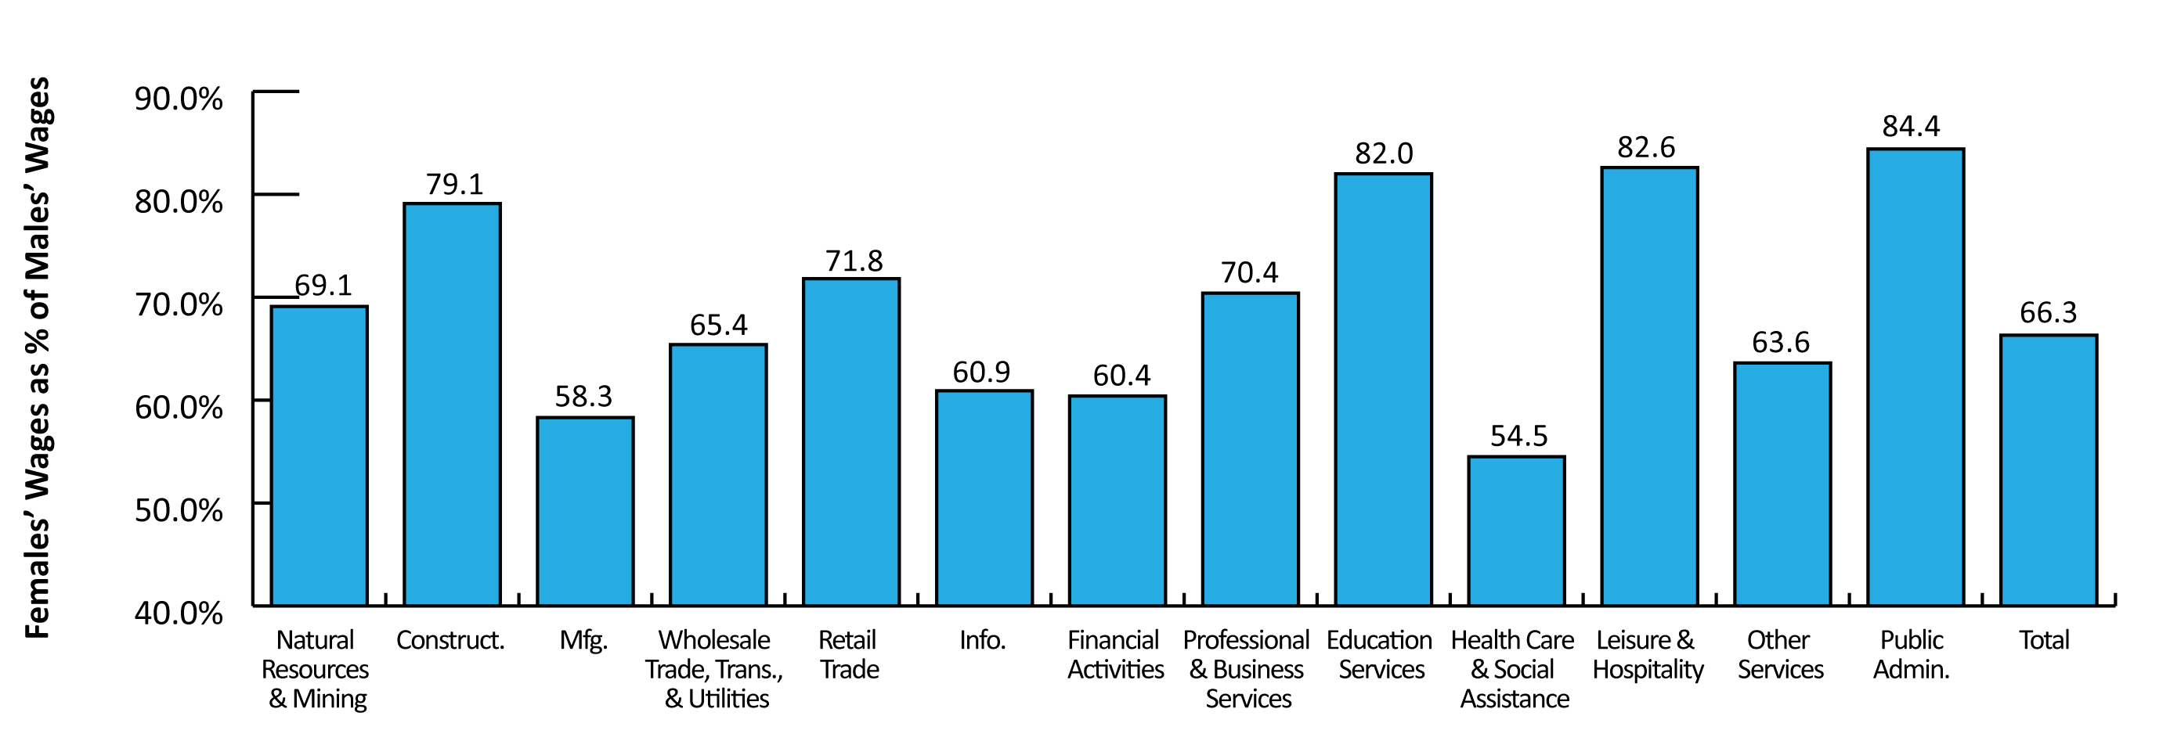
Women in Wyoming’s Labor Market
Gender Wage Gap
Females’ Wages as % of Males’ Wages by Industry, 2024
Source: Demographics of the Workforce, Research & Planning, WY DWS.
Notes:
This graph shows females’ wages as a percent of males’ wages by industry in 2024.
Once again, the overall gender wage gap was 66.3 cents on the dollar, which is the very last bar in this graph.
Industries with narrower wage gaps included public administration (84.4), leisure & hospitality (82.6), educational services (82.0), and construction (79.1).
The wage gap was widest in health care & social assistance (54.5) and manufacturing (58.3).

Slide 32
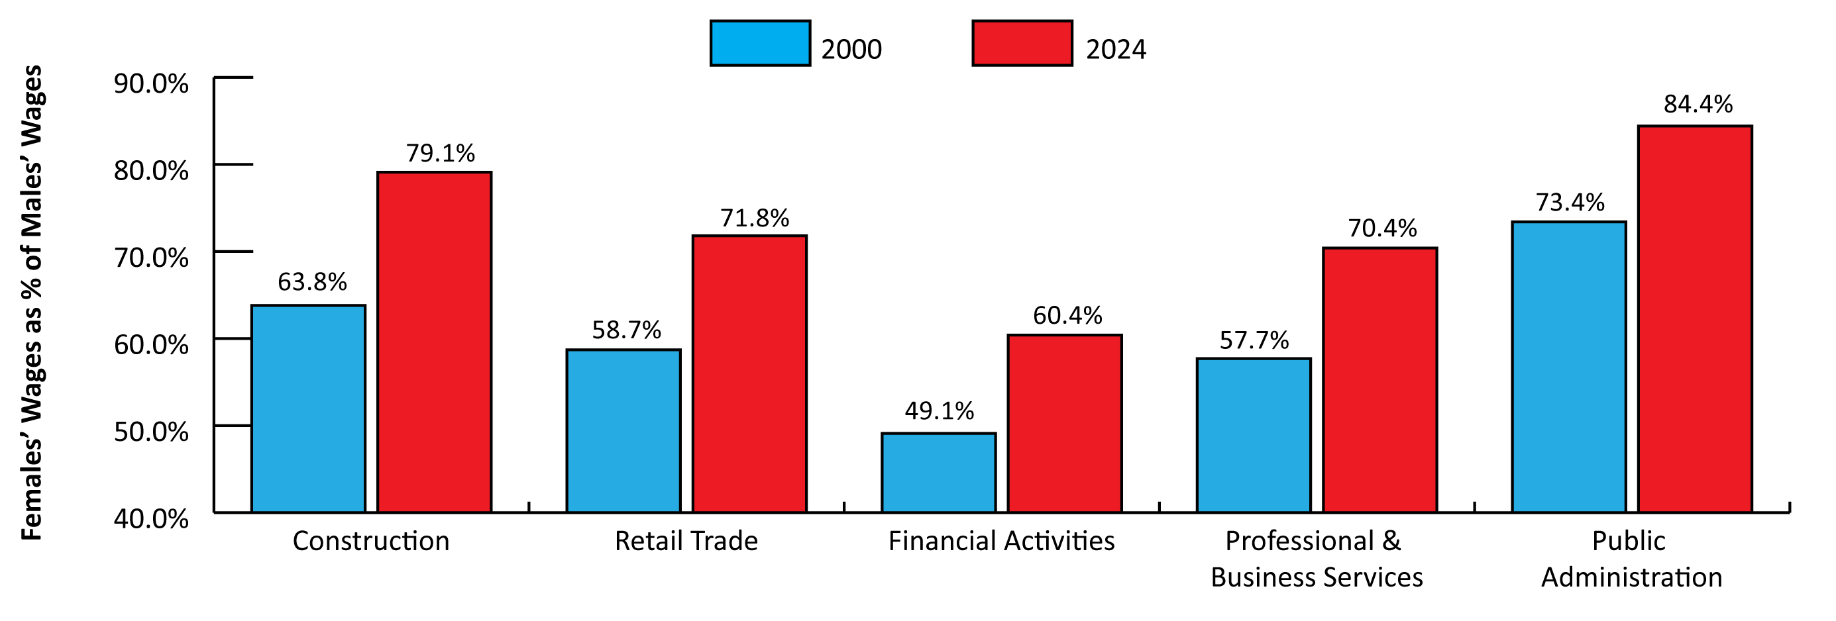
Women in Wyoming’s Labor Market
Gender Wage Gap
Females’ Wages as % of Males’ Wages by Selected Industry, 2000 and 2024
Source: Demographics of the Workforce, Research & Planning, WY DWS.
Notes:
Females have seen some gains in most industries. This chart shows the 5 industries with the greatest narrowing of the gender wage gap from 2000 to 2024.
In construction, females’ wages as a percentage of males’ wages increased from 63.8% to 79.1%; however, it’s important to note that females made up just 8% of all persons working in construction in 2024, so this increase didn’t affect many people.
In retail trade we saw a change from 58.7% to 71.8%; but this is typically an industry with low wages, so the narrowing of the wage gap may not mean a whole lot.
The next 3 industries are pretty interesting. In financial activities we saw a change from 49.1% to 60.4%. This is an industry where females typically make up a larger percent of the workforce than males. This industry is a combination of finance & insurance and real estate & rental & leasing.
In professional & business services there was a change from 57.7% to 70.4%, and this is also an industry where we’ve seen more and more females working in recent years. I’ll talk about this again in a bit when I get to recent trends.
And finally, females’ wages as percent of males’ wages in public administration increased from 73.4% to 84.4%. This is an industry with a lot of relatively higher paying jobs, many of which require a postsecondary education.

Slide 33
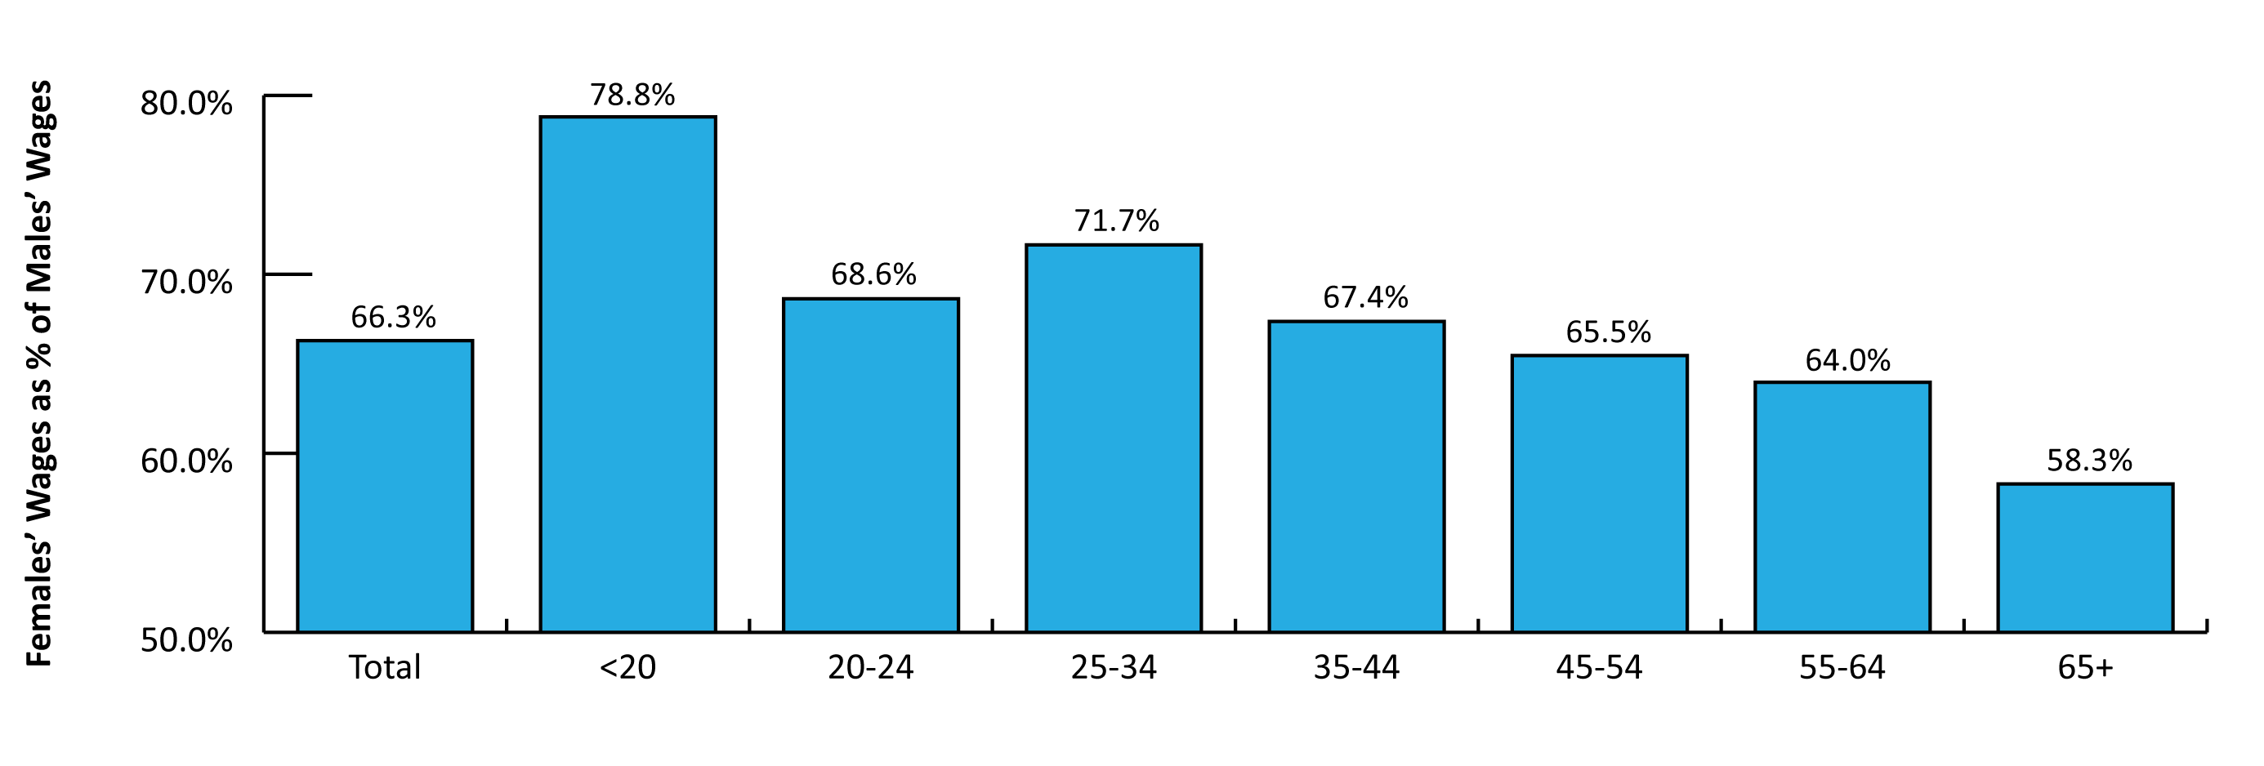
Women in Wyoming’s Labor Market
Gender Wage Gap
Females’ Wages as % of Males’ Wages by Age Group
Source: Demographics of the Workforce, Research & Planning, WY DWS.
Notes:
The gender wage gap generally widens with age.
Again, overall, females earned 66.3% of males’ earnings in 2024.
The wage gap was narrowest for those under 20 at 78.8%. This is because both males and females are entering the workforce and have low earnings.
The 20-24 age group is a little different, but after that we see a trend.
The wage gap widens from 71.7% for those 25-34 to 67.4% for 35-44, 65.5% for those 45-54, 64.0% for those 55-64, and 58.3% for those 65 and older.

Slide 34
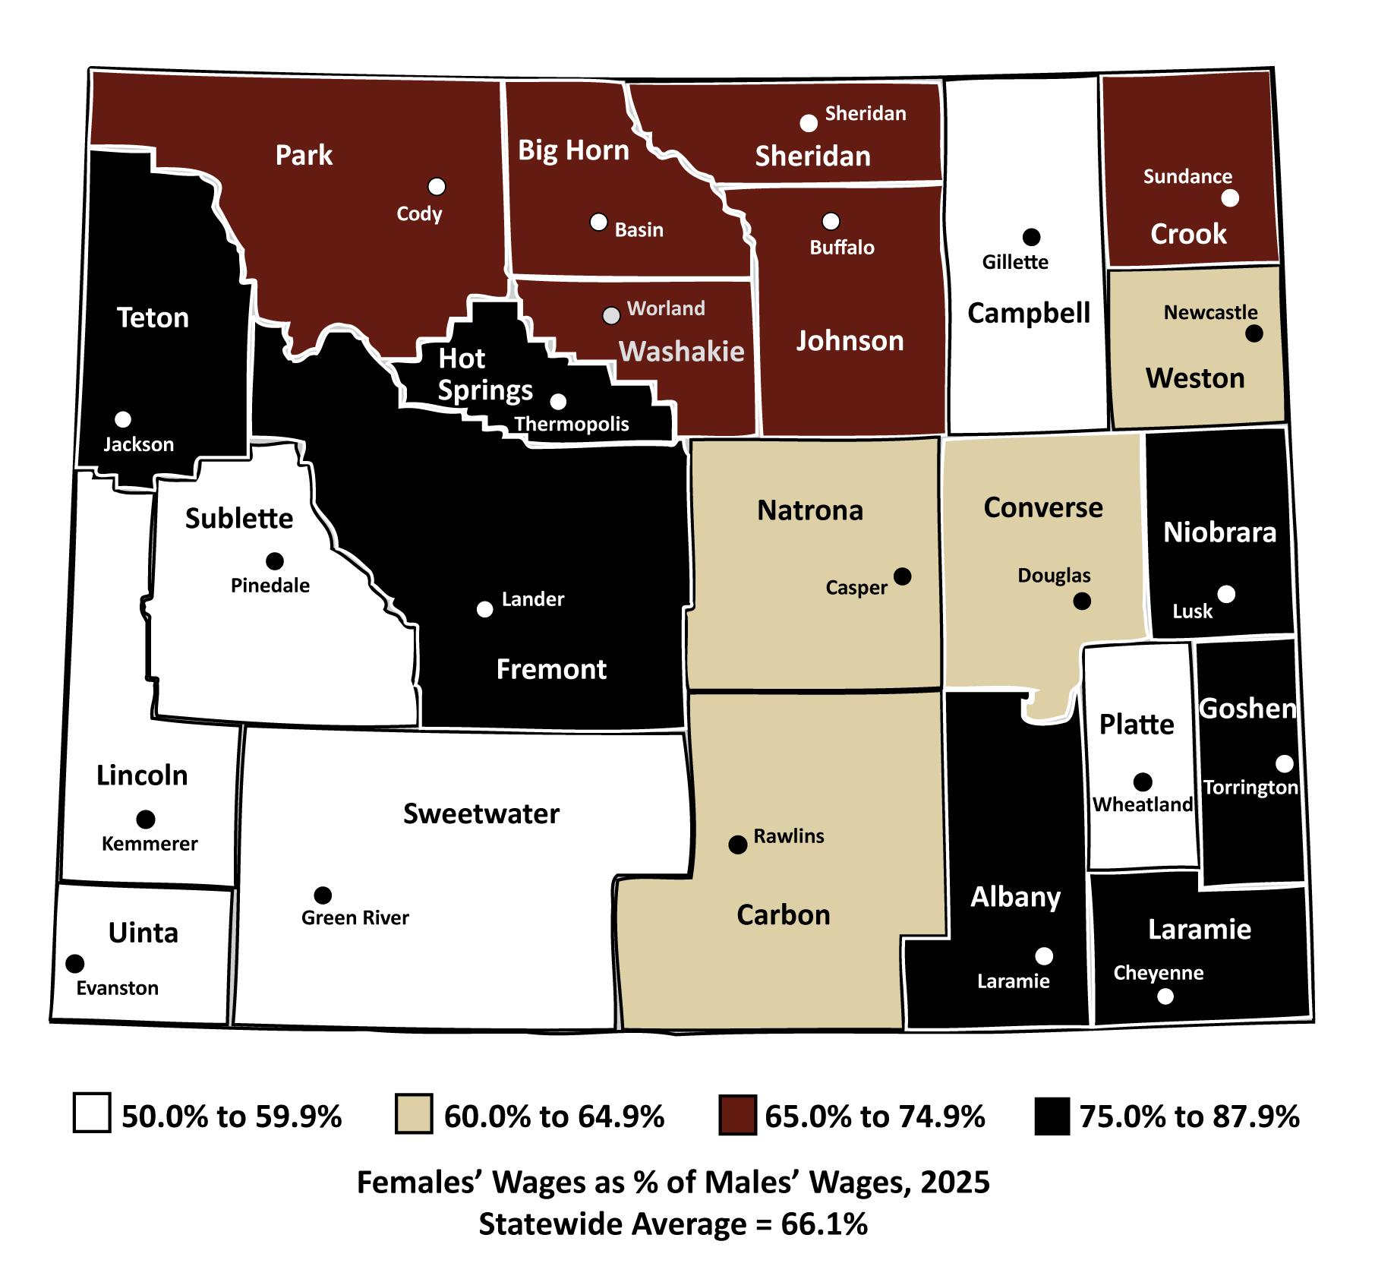
Women in Wyoming’s Labor Market
Gender Wage Gap
Females’ Wages
as % of Males’ Wages
by County of Employment
Source: Demographics of the Workforce, Research & Planning, WY DWS.
Notes:
The gender wage gap, as I’m sure you can guess, also varies by county, and there are a lot of factors that go into that.
The counties in white here have a wider wage gap, as females’ wages are fewer cents on the dollar. A lot of those counties are ones where mining-related jobs make up a relatively large proportion of total employment. Those are often higher-paying jobs that are typically worked by males, such as Campbell and Sweetwater.
The counties in black have narrower wage gaps, and there are several reasons for that.
For example, females earned more than 75% of males’ wages in Albany and Laramie County. These counties have large numbers of jobs in public administration and educational services, two industries with higher-paying jobs that require postsecondary education and are often worked by females.

Slide 35
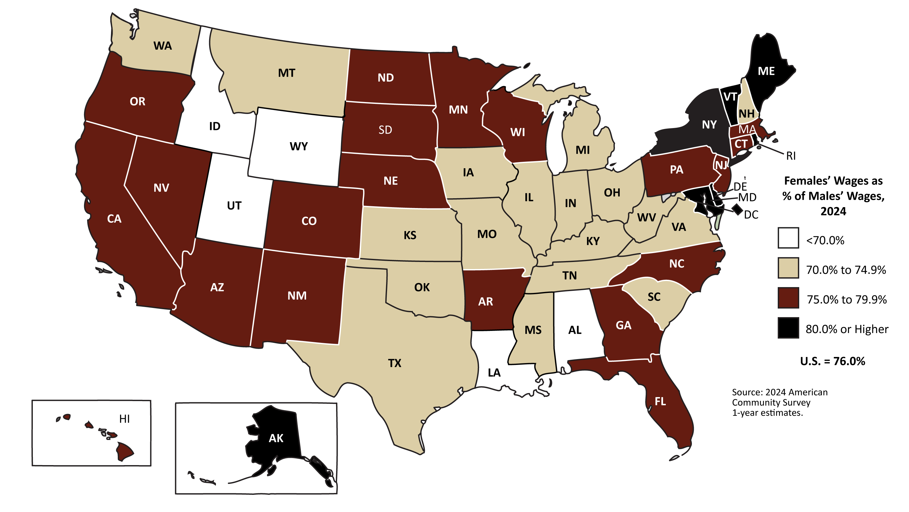
Women in Wyoming’s Labor Market
Gender Wage Gap
Females’ Wages
as % of Males’ Wages
by State
Source: American Community Survey, U.S. Census Bureau.
Notes:
When we look at the gender wage gap by state, Wyoming has one of the widest, along with nearby states like Idaho and Utah; these states are colored white. In this graph, the darker the color, the narrower the wage gap
Many of the states with the narrowest wage gap were in the northeast, such as Maine, Vermont, and New York.

Slide 36
Women in Wyoming’s Labor Market
Part 3: Recent Trends
Notes:
Finally, I will wrap up by looking at some recent trends that we have identified.

Slide 37
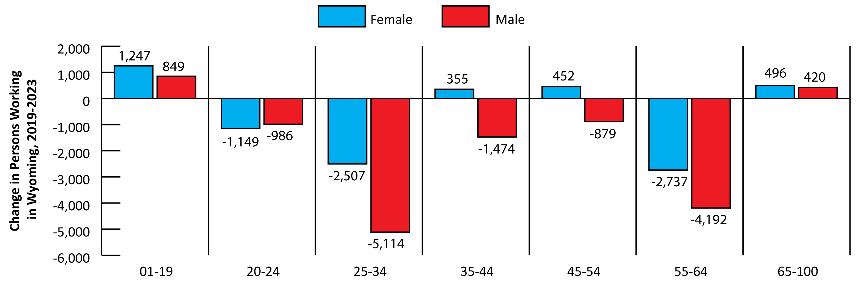
Women in Wyoming’s Labor Market
Recent Trends
Change in the Number of Persons Working by Sex and Age, 2019-2023
Source: Demographics of the Workforce, Research & Planning, WY DWS.
Notes:
In recent years, we’ve seen an increase in females across a few age groups where we saw a decrease or a smaller increase in males.
For this example, I looked at the change from 2019 to 2023.
Looking at younger workers (under 20), the number of females working in Wyoming increased by 1,247 individuals, compared to 849 males.
We also saw modest increases in females working in the 35-44 and 45-54 age groups, and both of those age groups saw more substantial decreases in the number of males working.
Finally when we look at the 65 and older age group, we saw an increase of 496 females compared to 420 males.
You’ll also notice we saw a much greater decrease in males working in the 25-34 and 55-64 age groups.

Slide 38
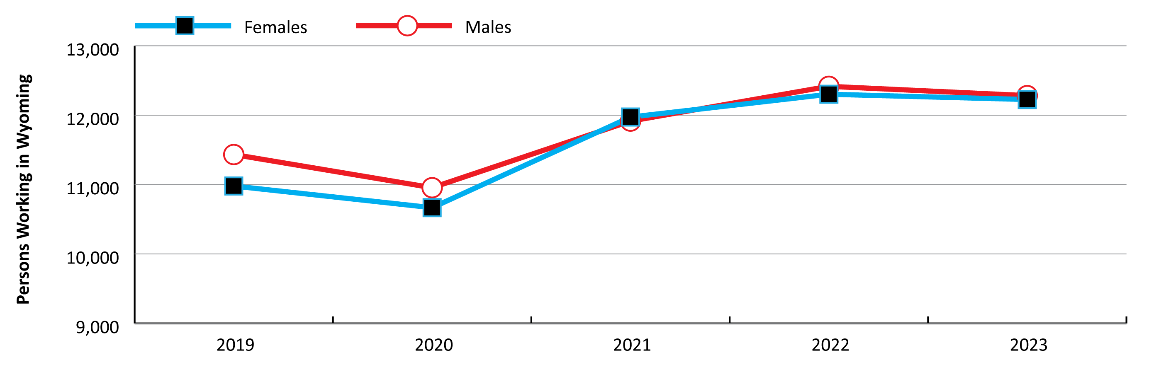
Women in Wyoming’s Labor Market
Recent Trends
Persons Younger than 20 Working in Wyoming by Sex, 2019-2023
Source: Demographics of the Workforce, Research & Planning, WY DWS.
Notes:
Looking at the increase in youth working in Wyoming, you can see there is a pretty similar number of females and males.
But over the last few years, we have seen a greater increase in young females than young males working in Wyoming.

Slide 39
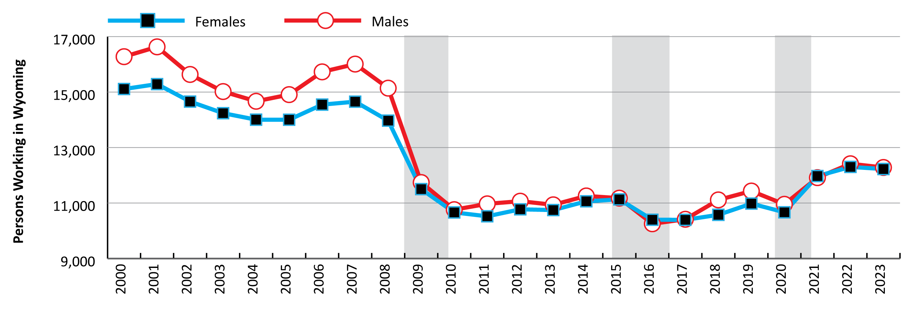
Women in Wyoming’s Labor Market
Recent Trends
Persons Younger than 20 Working in Wyoming by Sex, 2000-2023
Source: Demographics of the Workforce, Research & Planning, WY DWS.
Notes:
In fact if we go back to 2000, we can see that prior to the 2009/10 economic downturn (and national great recession), young males made up a larger number of youth working in Wyoming than young females.
But since then, the number of young females and males has been pretty close.

Slide 40
Women in Wyoming’s Labor Market
Recent Trends
Increase in Females Younger than 20 by Industry, 2019-2023
Leisure & Hospitality: 633, 12.5%
Retail Trade: 237, 10.8%
Health Care & Social Assistance: 192, 18.3%
Notes:
Breaking down that increase of young females working from 2019 to 2023 by industry, the greatest increases were seen in:
Leisure & hospitality, with 633 more young females, or 12.5%
Retail trade, 237, or 10.8%
Health care & social assistance, 192, 18.3%

Slide 41
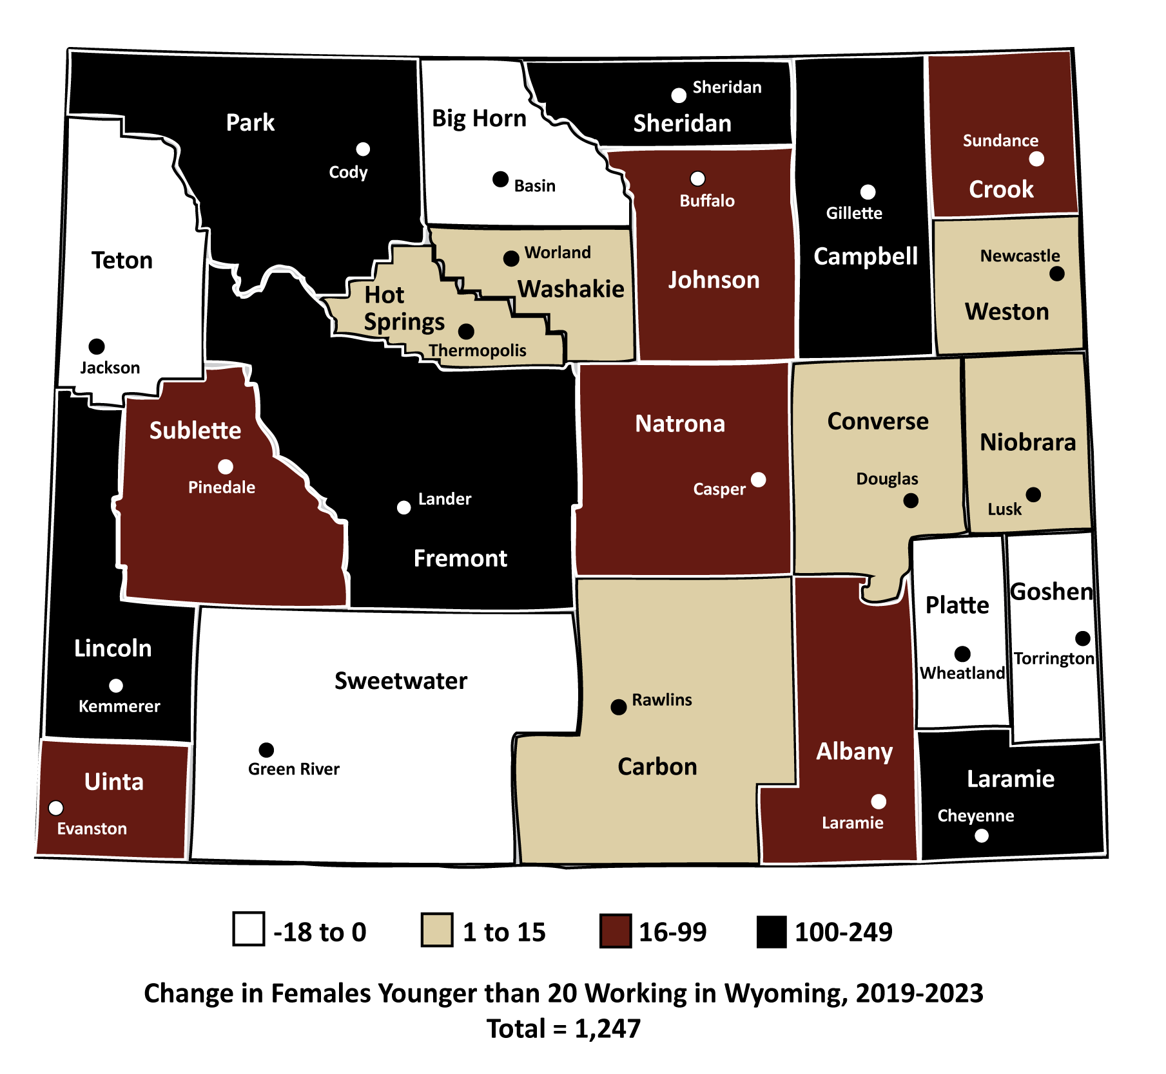
Women in Wyoming’s Labor Market
Recent Trends
Increase in Females Younger
than 20 Working by County,
2019-2023
Campbell: 249, 26.5%
Fremont: 130, 20.6%
Sheridan: 120, 21.0%
Park: 115, 19.8%
Laramie: 107, 5.5%
Lincoln: 103, 27.6%
Source: Demographics of the Workforce, Research & Planning, WY DWS.
Notes:
Six counties had an increase of at least 100 females younger than 20 from 2019 to 2023 working in Wyoming, including:
Campbell County, with 249 more young females, or 26.5%
Fremont, with 130, or 20.6%
Sheridan, 120, or 21.0%
Park, 115, 19.8%
Laramie, 107, 5.5%
Lincoln, 103, 27.6%

Slide 42
Women in Wyoming’s Labor Market
Recent Trends
What is Professional & Business Services?
Supersector made up of three sectors:
  Professional & technical services
  Management of companies & enterprises
  Administrative & waste services
Source: North American Industry Classification System.
Notes:
One of the most interesting trends I noticed was the increase in females working in the industry titled professional & business services from 2019 to 2023.
So what exactly is professional & business services? While some industry titles are self-explanatory, like mining, construction, or health care, this one is a little different.
Professional & business services is a supersector made up of three sectors:
Professional & technical services
Management of companies & enterprises
Administrative & waste services
So what does all that mean? This industry supersector includes businesses involved in things like temporary employment staffing, computer systems designs, legal services, architectural & engineering services, and a whole lot more.

Slide 43
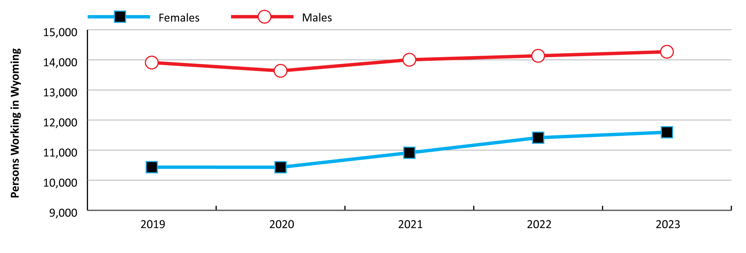
Women in Wyoming’s Labor Market
Recent Trends
Persons Working in Professional & Business Services by Sex, 2019-2023
Source: Demographics of the Workforce, Research & Planning, WY DWS.
Notes:
You can see by the blue line at the bottom that we’ve seen a pretty consistent increase females working in this industry over the last few years.
From 2019 to 2023, the number of females working in professional & business services increased by 1,161, or 11.1%.
In contrast, the number of males working increased by 358, or 2.6%.

Slide 44

Women in Wyoming’s Labor Market
Contact Us
Michael Moore, Research Supervisor
(307) 473-3814
Michael.Moore@wyo.gov
444 W. Collins Drive
Suite 3100
Casper, WY 82601
https://doe.state.wy.us/LMI
Notes:
With that I will go ahead and wrap up the presentation.
Thank you for inviting me to speak here today.
If you have any questions or need any assistance finding particular data, please feel free to reach out to me. My phone number and email address are provided on this slide, along with our physical address and website.

