Slide 1
Youth in Wyoming and its Labor Market
Presented to the Wyoming Workforce Development Council by Michael Moore, R&P Research Supervisor, Thursday, November 6, 2025
Notes:
Good afternoon, my name is Michael Moore and I am the research supervisor for R&P.
Thank you for giving me the time today to talk to you a little bit about a couple of articles on Youth in Wyoming and its Labor Market.

Slide 2
Youth in Wyoming and its Labor Market
About Research & Planning
OUR ORGANIZATION:
R&P is an exclusively statistical entity within DWS.
WHAT WE DO:
R&P collects, analyzes, and publishes timely and
accurate labor market information (LMI)
meeting established statistical standards.
OUR CUSTOMERS:
LMI makes the labor market more efficient by
providing the public and the public’s
representatives with the basis for
informed decision making.
Notes:
Just a little bit about Research & Planning to get us started.
R&P is an exclusively statistical entity within DWS.
We collect, analyze and publish timely labor market information (LMI) data.
We provide this information to the public, legislators, educators, training providers, the media, and more.

Slide 3
Youth in Wyoming and its Labor Market
Wyoming Labor Force Trends, October 2025
https://doe.state.wy.us/LMI/trends/1025/toc.htm
Tracking Youth into Wyoming's Labor Market: 2025 Update
Examining Millennials’ Departure From Wyoming
Notes:
I put this presentation together from two articles in the October 2025 issue of Wyoming Labor Force Trends.
The first part of this presentation provides data from an article titled, “Tracking Youth into Wyoming’s Labor Market: 2025 Update”
The second part is based on the article titled, “Examining Millennials’ Departure from Wyoming”
This issue of Trends is available on our website at the URL at the top of this slide.

Slide 4
Youth in Wyoming and its Labor Market
Wyoming Labor Force Trends, October 2025
https://doe.state.wy.us/LMI/trends/1025/toc.htm
Part 1: Tracking Youth into Wyoming's
Labor Market: 2025 Update
Notes:
I’ll start off with some data from the first article, titled, “Tracking Youth into Wyoming's Labor Market: 2025 Update”

Slide 5
Youth in Wyoming and its Labor Market
Tracking Youth into Wyoming's Labor Market: 2025 Update
A Decade Later and Another Decade Later
Tracks high school seniors into labor market up to 10 years later
14 cohorts of high school seniors: 2010/11 to 2023/24
Based on data from WDE684 File linked to R&P administrative files
Notes:
R&P has authored two similar publications with this type of research:
A Decade Later in 2012 and Another Decade Later in 2021
This research, likes those two, tracks Wyoming high school seniors into the labor market each year up to 10 years later
We have data for 14 cohorts, or Wyoming high school senior classes, from 2010/11 to 2023/24
For this research, we linked data from the Wyoming Department of Educations 684 file to R&P administrative files
Just a quick note: While “Another Decade Later” tracked high school seniors into postsecondary education, this research does not do so, as that type of research is now being done by the Wyoming Statewide Longitudinal
Education Data System program, or SLEDS

Slide 6
Youth in Wyoming and its Labor Market
Tracking Youth into Wyoming's Labor Market: 2025 Update
Highest number of seniors working is in their senior year
Decreases each year after
Average 5-year retention rate: 55.1%
Average 10-year retention rate: 46.1%
Notes:
I’ll go over some of the findings discussed in this article:
The highest number of any senior cohort was found working during the students’ senior year.
The number working decreased each year after.
From the cohorts we have, we have five-year retention rates for 10 of them. The average 5-year retention rate was 55.1%.
So, for all the high school seniors in Wyoming for each year, a little more than half were found working in Wyoming five years later.
We have 10-year retention rates for only 5 cohorts; that’s just a function the data available to us.
The average 10-year retention rate for those 5 cohorts was 46.1%.

Slide 7
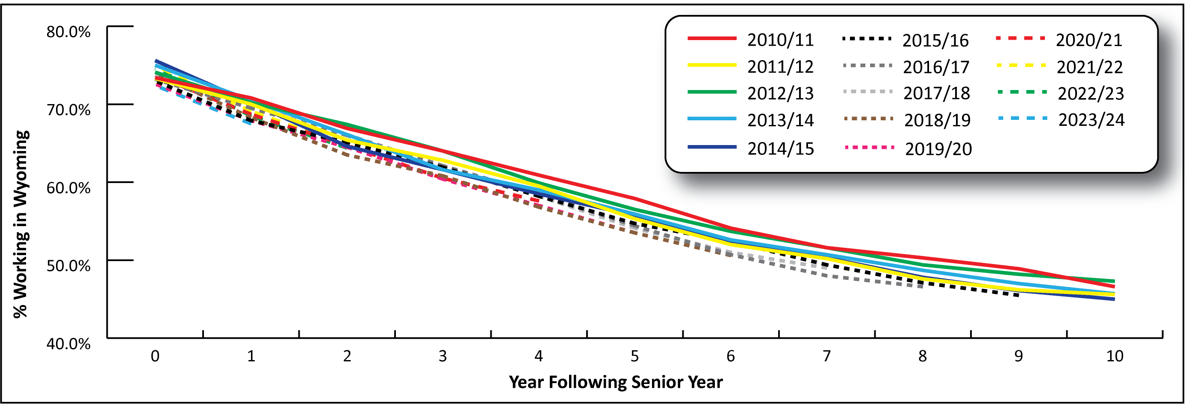
Youth in Wyoming and its Labor Market
Tracking Youth into Wyoming's Labor Market: 2025 Update
High School Seniors Found Working in Wyoming Up to 10 Years Later
Notes:
One thing we’ve found is that all cohorts follow the same general pattern.
This is Figure 1 from the article, showing the number of high school seniors working in Wyoming up to 10 years later for each cohort from 2010/11 to 2023/24.
What this figure shows us is that the youth exodus from Wyoming is not new. It has followed the same pattern for many years.

Slide 8
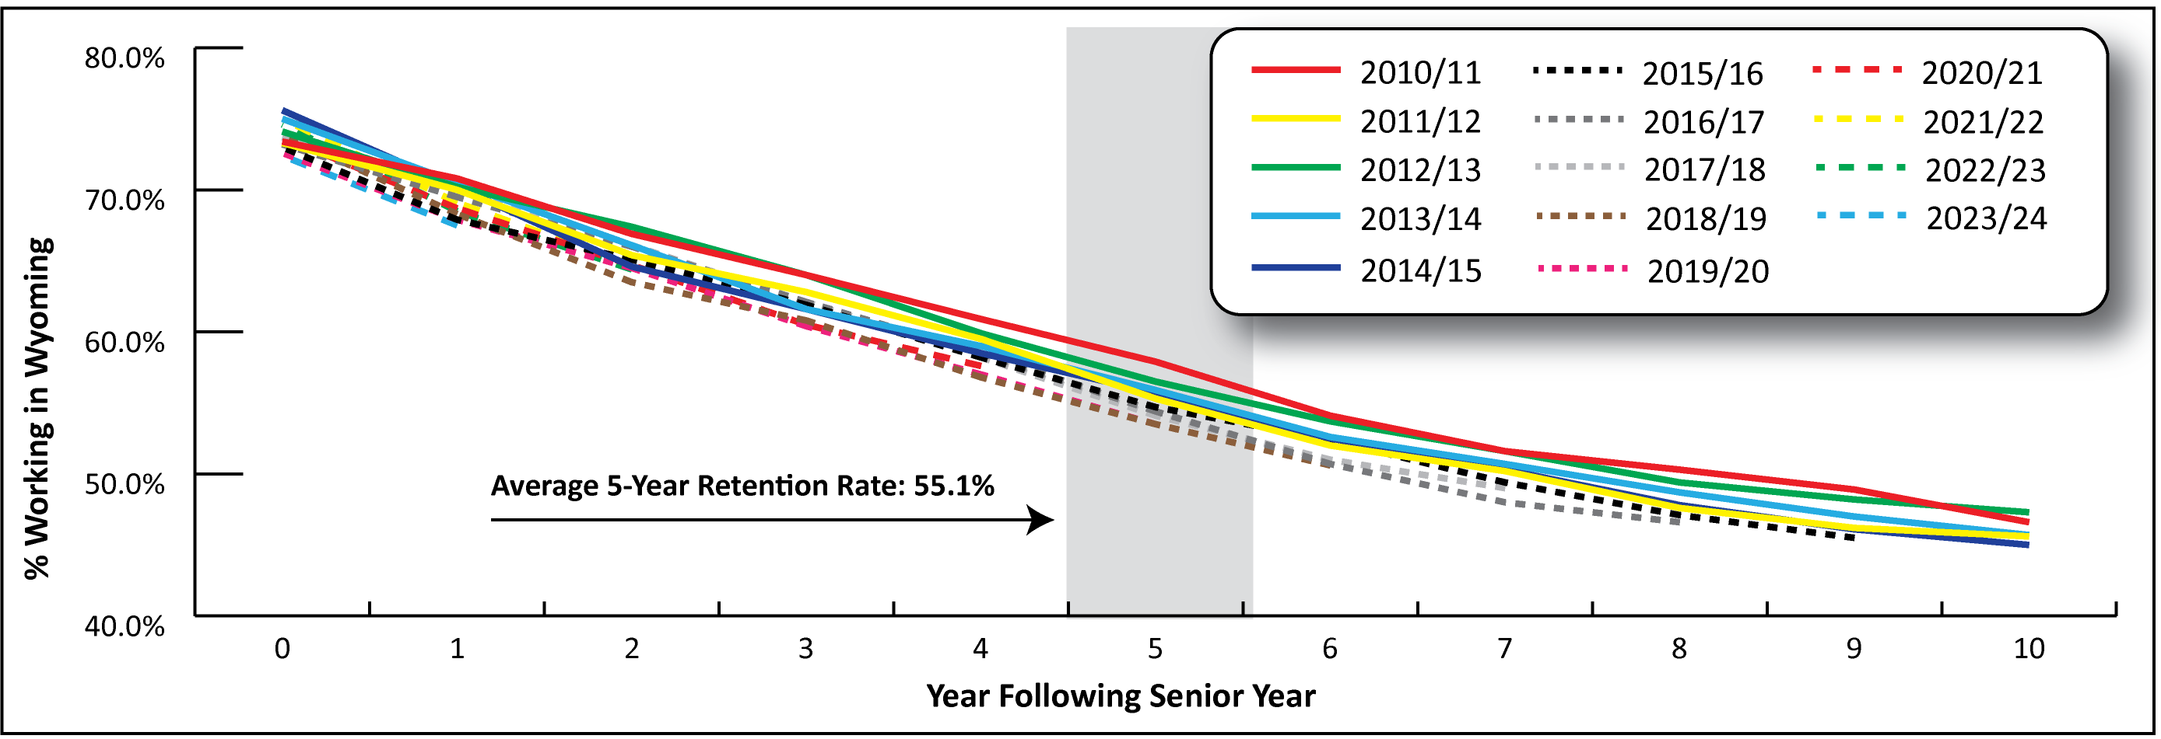
Youth in Wyoming and its Labor Market
Tracking Youth into Wyoming's Labor Market: 2025 Update
High School Seniors Found Working in Wyoming Up to 10 Years Later
Notes:
You can see the average 5-year retention rate of 55.1%

Slide 9
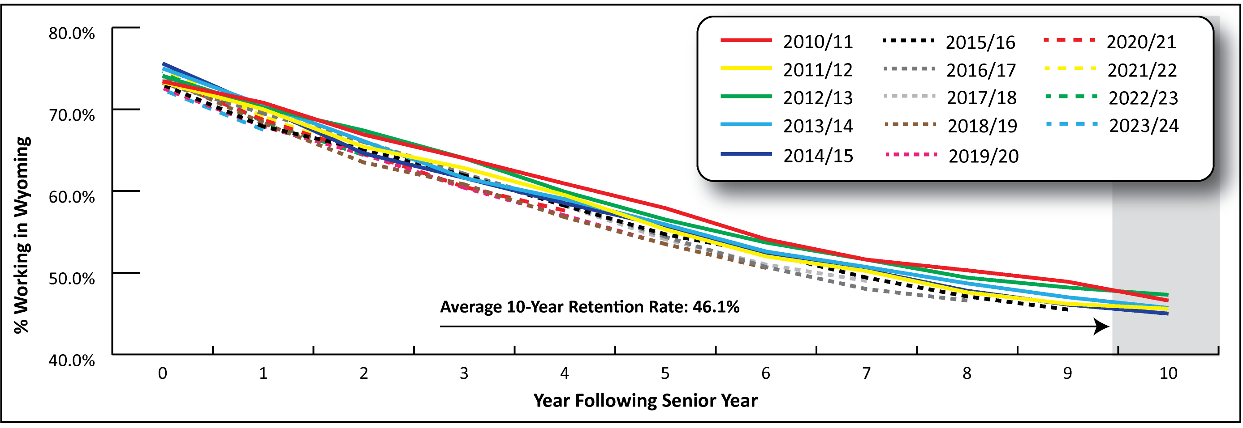
Youth in Wyoming and its Labor Market
Tracking Youth into Wyoming's Labor Market: 2025 Update
High School Seniors Found Working in Wyoming Up to 10 Years Later
Notes:
And the average 10-year retention rate of 46.1%

Slide 10
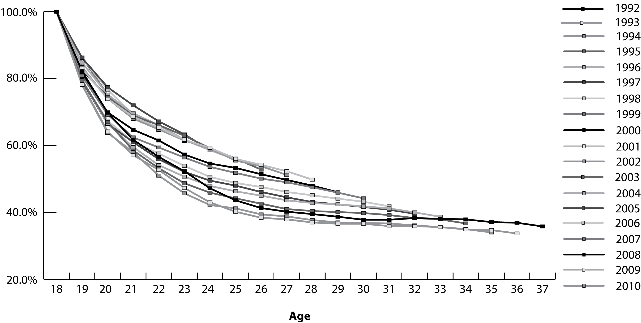
Youth in Wyoming and its Labor Market
Tracking Youth into Wyoming's Labor Market: 2025 Update
From A Decade Later, 2011
Notes:
In fact, if we go back to the research we did in “A Decade Later” back in 2012, we see the same pattern.
The methodology was a little different, as we looked at 18-year-olds from any given year, rather than high school seniors.
In that research, we looked at 18-year-olds for every year from 1992 to 2010.
While the methodology was different, the results were very similar: a little more than half of 18 year olds or high school seniors were found working in Wyoming five years later, and just over 40% were found working in Wyoming 10 years later.

Slide 11
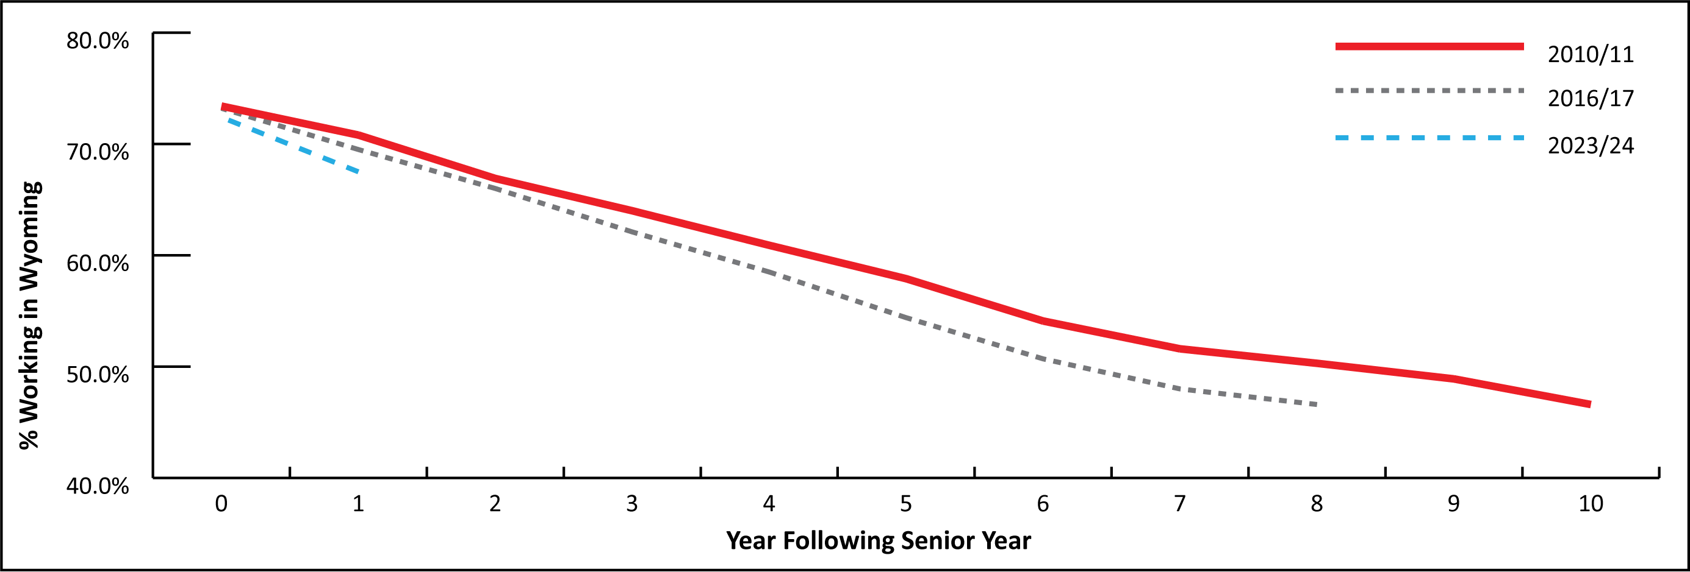
Youth in Wyoming and its Labor Market
Tracking Youth into Wyoming's Labor Market: 2025 Update
High School Seniors Found Working in Wyoming Up to 10 Years Later
Notes:
So we can see this phenomenon of youth leaving Wyoming isn’t new.
And really, it hasn’t changed a lot over time.
For this graphic, I included just the lines representing the 2010/11, 2016/17, and 2023/24 cohorts.
The 5-year retention rate between the 2010/11 and 2016/17 cohorts hasn’t changed much: 57.9% to 54.4%. So it’s gone down a little bit, but it doesn’t appear to be too substantial.
And the percent of seniors found working in Wyoming one year later went from 70.8% for the 2010/11 seniors to 67.5% for the 2023/24 seniors.
So a somewhat smaller proportion of seniors are working, but it doesn’t seem to be a whole lot different.

Slide 12
Youth in Wyoming and its Labor Market
Tracking Youth into Wyoming's Labor Market: 2025 Update
Graduates and non-graduates
14 cohorts: 2010/11 to 2023/24
Seniors who graduated were more likely to be found working in WY
Graduates were also retained at a greater rate
Notes:
As part of this research, we also looked at whether individuals graduated or not.
Once again, we have data for 14 cohorts from 2010/11 to 2023/24.
What we found was that seniors who graduated were more likely to work in Wyoming than non-graduates during their senior year.
77.0% of graduates worked during their senior year, compared to 45.4% of non-graduates. Some of this may be a function of non-graduates leaving Wyoming during the school year.
We also found that graduates were retained at a greater rate than non-graduates.
On average, the five-year retention rate for seniors working in Wyoming was 57.2% for graduates and 36.9% for non-graduates.

Slide 13
Youth in Wyoming and its Labor Market
Tracking Youth into Wyoming's Labor Market: 2025 Update
2014/15 Employment by Industry
Leisure & Hospitality (29.5%)
Retail Trade (23.0%)
2014/15 Cohort by Industry 10 Years Later
More evenly distributed across industries
Health Care & Social Assistance (15.4%)
Notes:
For part of the article we focused on the 2014/15 class of high school seniors, as that is the most recent cohort for which we have data 10 years after graduation.
More than half of all high school seniors from that cohort worked in one of two industries during their senior year: 29.0% in leisure & hospitality and 22.9% in retail trade.
10 years later, the employment of the 2014/15 senior class still working in Wyoming was more evenly distributed across industries.
Of the 2014/15 seniors still working in Wyoming 10 years later, 15.4% were found working in health care & social assistance.

Slide 14
Youth in Wyoming and its Labor Market
Tracking Youth into Wyoming's Labor Market: 2025 Update
2014/15 Participation Rate by County
Highest: Platte County (82.5%)
Lowest: Crook County (64.3%)
2014/15 Cohort 10 Years Later
Highest: Converse County (53.9%)
Lowest: Teton & Niobrara counties (30.4%)
Notes:
We also looked at the number of seniors from 2014/15 working in Wyoming by county, both during their senior year and 10 years later.
Platte County had the highest percentage of seniors working in their senior year at 82.5%. Crook County had the lowest at 64.3%.
Looking at 10 years later, Converse County had the highest percentage working in Wyoming at 53.9%, while Teton and Niobrara had the lowest, each with 30.4%
Also, Platte County had one of the higher proportions working 10 years later, at 52.6%.

Slide 15
Youth in Wyoming and its Labor Market
Wyoming Labor Force Trends, October 2025
https://doe.state.wy.us/LMI/trends/1025/toc.htm
Part 2: Examining Millennials’ Departure From Wyoming
Notes:
I will move onto the second topic for today’s discussion, from the article titled, “Examining Millennials’ Departure from Wyoming”

Slide 16
Youth in Wyoming and its Labor Market
Examining Millennials’ Departure From Wyoming
Baby Boomers
Born 1946-1964
Ages 60-78 in 2024
Millennials
Born 1981-1996
Ages 28-43 in 2024
Notes:
This article focuses on two generations of people: baby boomers and millennials.
Baby boomers are those individuals born between 1946 and 1964.
In 2024, they were between the ages of 60 and 78.
Millennials are those individuals born from 1981 to 1996.
In 2024, millennials were between the ages of 28 and 43.

Slide 17
Youth in Wyoming and its Labor Market
Examining Millennials’ Departure From Wyoming
Why Millennials?
Largest number of working-age individuals nationally
Ages 28-43 in 2024 – working age
U.S. millennial population keeps growing with immigration
Notes:
Before we go any further, I just want to touch on why we singled out millennials for this research.
Nationally, there are more working-age millennials than any other generation.
As I mentioned, in 2024 millennials were between the ages of 28 and 43, so we’re talking about prime working-age.
The U.S. millennial population keeps growing due to immigration.

Slide 18
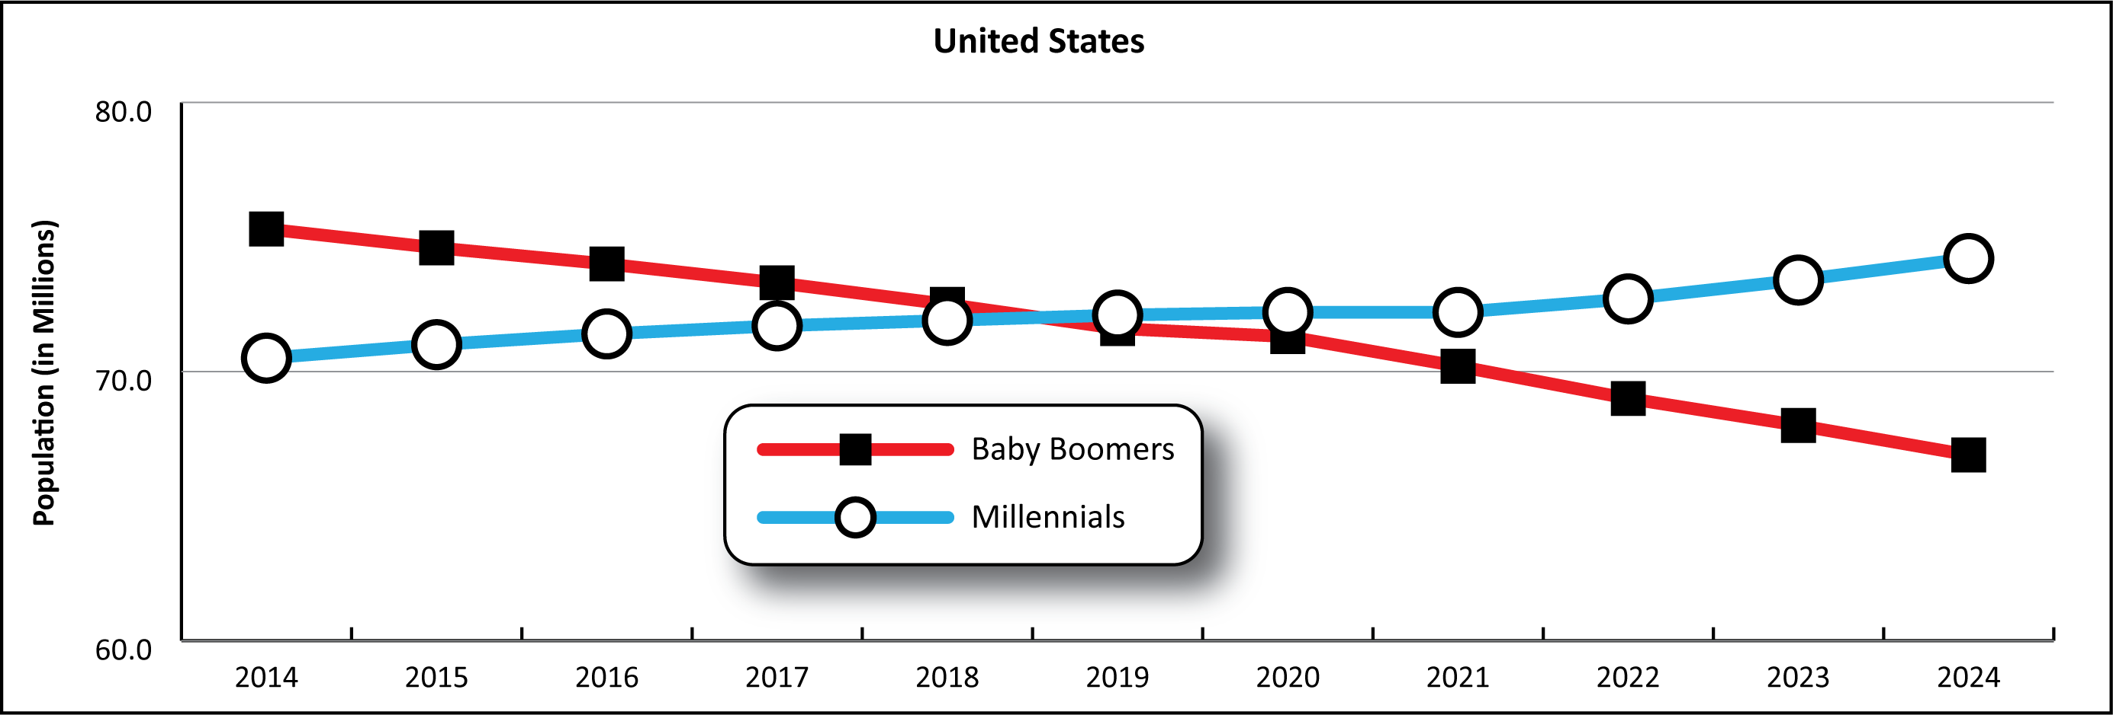
Youth in Wyoming and its Labor Market
Examining Millennials’ Departure From Wyoming
Baby Boomer and Millennial Populations in the U.S.
Notes:
As you can see in this graphic, the millennial population (the blue line) of the U.S. surpassed the baby boomer population (the red line) in 2019, and that trend has continued ever since.

Slide 19
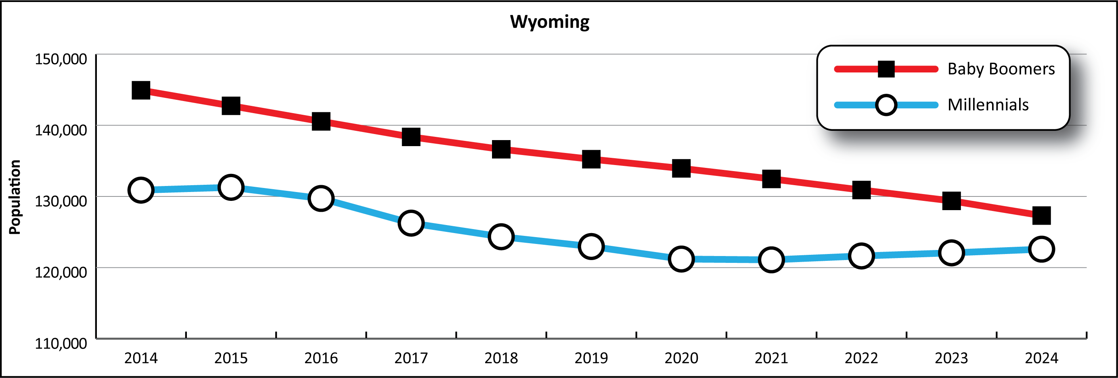
Youth in Wyoming and its Labor Market
Examining Millennials’ Departure From Wyoming
Baby Boomer and Millennial Populations in the U.S.
Notes:
In Wyoming, however, baby boomers continue to make up a larger proportion of our population than millennials as of 2024, which we see in this graphic.

Slide 20
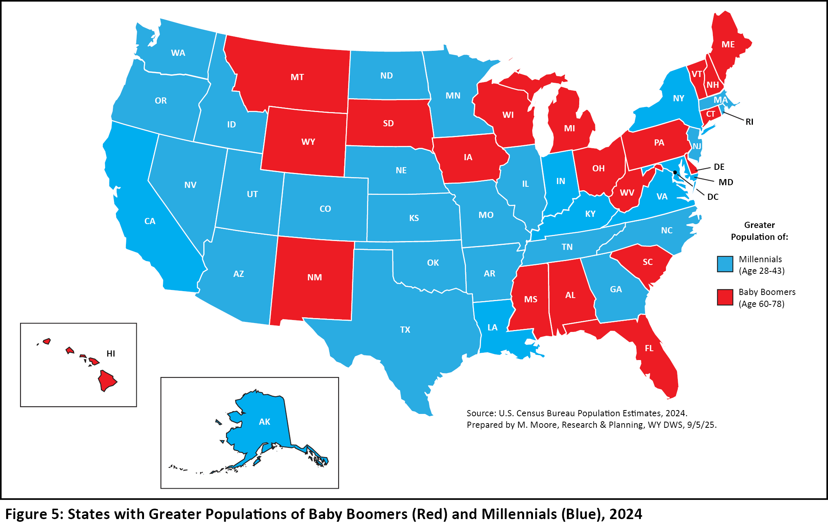
Youth in Wyoming and its Labor Market
Examining Millennials’ Departure From Wyoming
The Difference in Baby Boomers and Millennials by State
Notes:
Having a higher percentage of baby boomers than millennials isn’t that unique.
In 2024, Wyoming was one of 20 states with more baby boomers than millennials; these states are shown in red in this map.
The states marked in blue had more millennials than baby boomers.
You can see that most of our surrounding states had larger populations of millennials than baby boomers, with the exception of Montana and South Dakota.
Colorado had the second largest concentration of millennials, who made up 24.7% of the population, or one in five individuals.

Slide 21
Youth in Wyoming and its Labor Market
Examining Millennials’ Departure From Wyoming
Millennial Population
2014: 130,866
2024: 122,585
Difference: -8,301, or -6.3%
Millennials Working in Wyoming
2014: 122,076
2024: 98,925
Difference: -23,151, or -19.0%
Notes:
In addition to looking at the overall millennial population, this research also looks at millennials working in Wyoming.
In 2024, our millennial population was 122,585. Compared to 2014, that was a decrease of 8,301 individuals, or 6.3%.
However, we saw an even greater decrease in millennials working in Wyoming.
We had 98,925 millennials working in Wyoming in 2024, down more than 23,000 from 2014, or 19%.

Slide 22
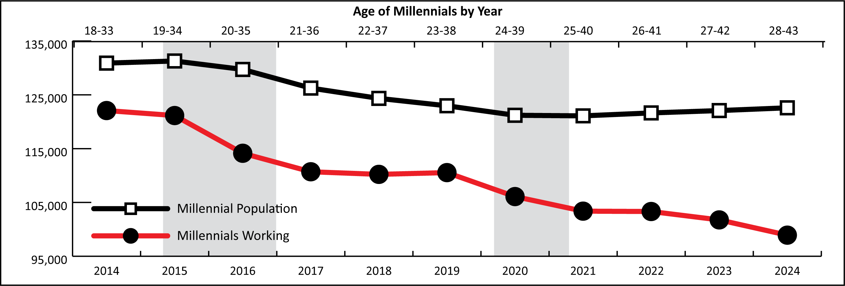
Youth in Wyoming and its Labor Market
Examining Millennials’ Departure From Wyoming
Millennial Population and Working in WY
Notes:
In this graphic, you can see just how much more the dramatic the decline in millennial workers was compared to the change in the population
In fact, during each of the last three years, we’ve seen moderate growth in the state’s millennial population, with an over-the-year increase of about 500 people per year.
But the number of millennials working in Wyoming continues to decline.
In 2024, the number of millennials working in Wyoming dipped below 100,000 for the first time since 2010.
At that time, millennials were between the ages of 14 and 29, so a good portion of those were not even in the workforce yet

Slide 23
Youth in Wyoming and its Labor Market
Examining Millennials’ Departure From Wyoming
Turning Point: 2015-16 Economic Downturn
Large decrease in millennials working in Wyoming from 2014 to 2017
Young workers lost jobs first
Surrounding states had growing economies
Notes:
Wyoming’s 2015/2016 economic downturn appears to have been a turning point for many Wyoming millennials.
That downturn was brought on by decreasing energy prices and demand, especially for coal.
Our research has shown that during economic downturns, young workers are often the first to lose their jobs, especially males.
In 2015, millennials were between the ages of 19 and 34. So they would certainly meet that criteria.
And one of the most important factors during this turning point was that all of our surrounding states had growing economies during that time.

Slide 24
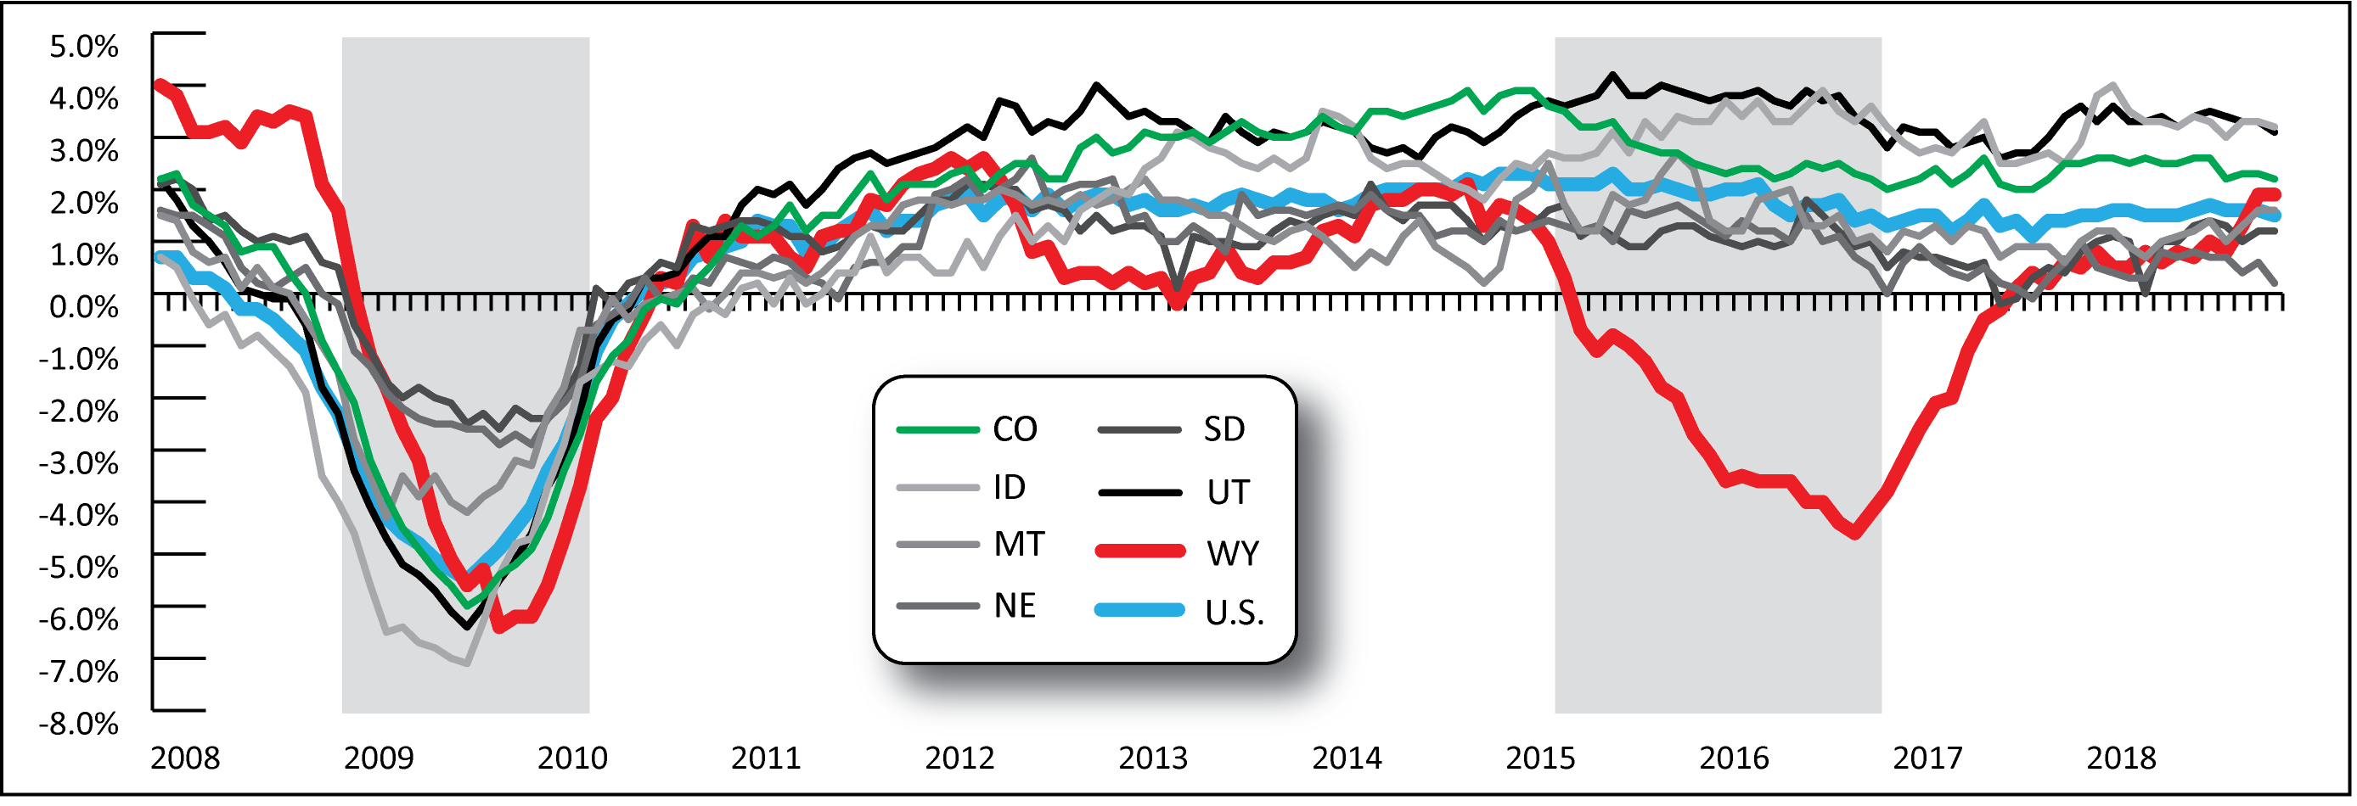
Youth in Wyoming and its Labor Market
Examining Millennials’ Departure From Wyoming
Over-the-Year Employment Change in WY and Surrounding States
Notes:
This graphic will help you visualize what made the 2015/2016 downturn so much different.
This graphic shows the over-the-year percent change in average monthly employment for the U.S., Wyoming, and our surrounding states from 2008 to 2018, based on data from the Quarterly Census of Employment and Wages, or QCEW.
You can see during the prior economic downturn in 2009 and 2010 (the gray bar on the left) that the U.S., Wyoming, and all of our surrounding states lost jobs. So people who lost jobs in Wyoming couldn’t necessarily pick up and find jobs in Colorado or Montana very easily.
But when we look at the 2015-16 downturn (the gray bar on the right), you can see that Wyoming lost jobs for a prolonged period of time. The red line in this figure represents Wyoming.
When we look at the U.S. and all of our surrounding states in 2015 and 2016, we see continued job growth of anywhere from 1% to 4%.
So it is entirely possibly that plenty of millennials were able to pick up and move to one of our surrounding states to find a new job.

Slide 25

Youth in Wyoming and its Labor Market
Examining Millennials’ Departure From Wyoming
Millennial Population and Working in WY
Notes:
So again when we go back to this graphic of the millennial population and millennials working, we see how quickly the number of millennials working dropped after 2014 during that downturn.

Slide 26
Youth in Wyoming and its Labor Market
Conclusions
Departure of youth isn’t new, but is accelerating
55.1% of high school seniors working in WY 5 years later
46.1% 10 years later
Large departure of millennials from WY workforce
2015/16 downturn was a turning point
Notes:
So just to wrap things up today:
We know the departure of youth from Wyoming isn’t new.
Of all the senior years we looked at beginning with 2010/11, 55.1% of all high school seniors on average were found working in Wyoming 5 years later, and 46.1% were found working 10 years later
Wyoming has seen a large departure of millennials from its workforce, and these are prime working-age individuals
The departure of millennials seems to have really picked up during the state’s 2015/16 downturn, and the number of millennials working in Wyoming continues to decrease

Slide 27

Youth in Wyoming and its Labor Market
Contact Us
Michael Moore, Research Supervisor
(307) 473-3814
Michael.Moore@wyo.gov
444 W. Collins Drive
Suite 3100
Casper, WY 82601
https://doe.state.wy.us/LMI
Notes:
With that I will go ahead and wrap up the presentation.
Thank you for inviting me to speak here today.
If you have any questions or need any assistance finding particular data, please feel free to reach out to me. My phone number and email address are provided on this slide, along with our physical address and website.

